Slide 1
Climate Crisis and Carbon Pricing
Dianne Saxe SaxeFacts.com
Kingston
Sept. 19/20, 2019

Slide 2
OVERVIEW
Why a carbon price?
How it works
What else we need

Slide 3
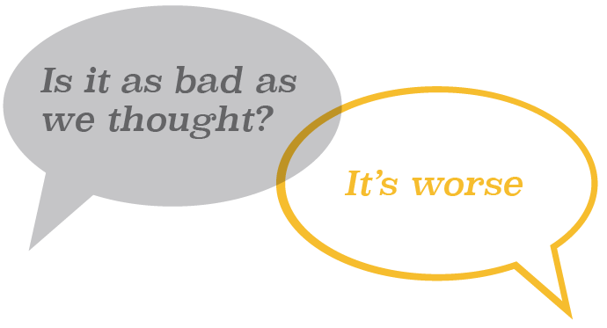
Climate Crisis is here It affects us now Much worse is Ahead
3

Slide 4
People cause Climate Crisis by:
Putting greenhouse gases in the atmosphere that keep solar heat from escaping
Mostly CO₂ from burning fossil fuels

Slide 5
Canada is A Big part of the Problem
A Top 10 emitting country
Now and cumulative
Among world’s largest per capita emitters

Slide 6
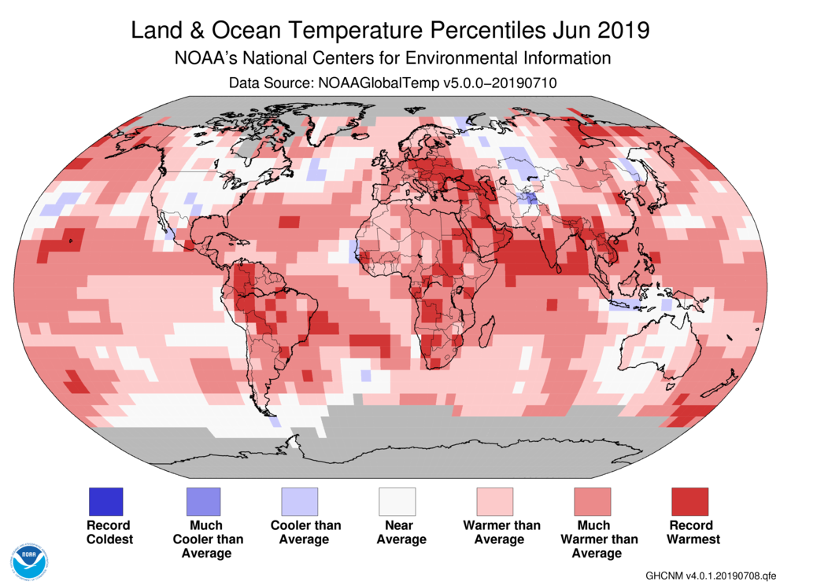
This Is Giving the world a fever
Highest recorded:
GHG emissions
GHGs in atmosphere
Temperatures
Ocean acidity
Source: National Aeronautics and Space Administration, State of the Climate
Global Analysis, 2016.

Slide 7
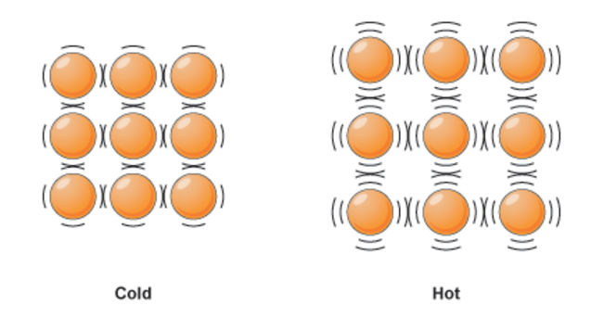
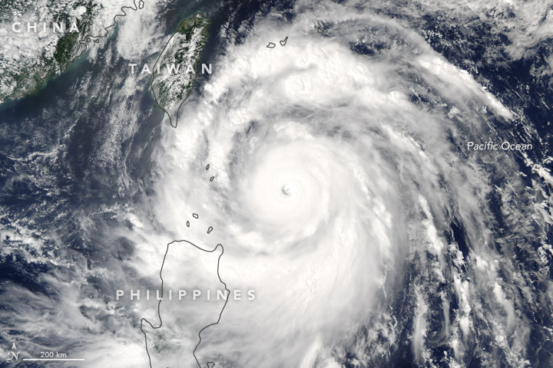
Especially the Oceans

Slide 8
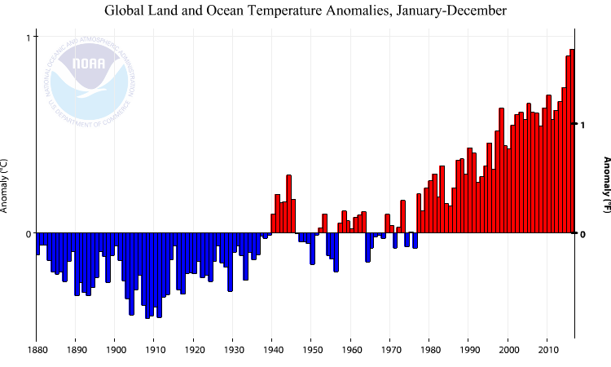
20th Century “normal” is gone
Source: National Oceanic and Atmospheric Administration, Climate Change – Global Temperature
8

Slide 9
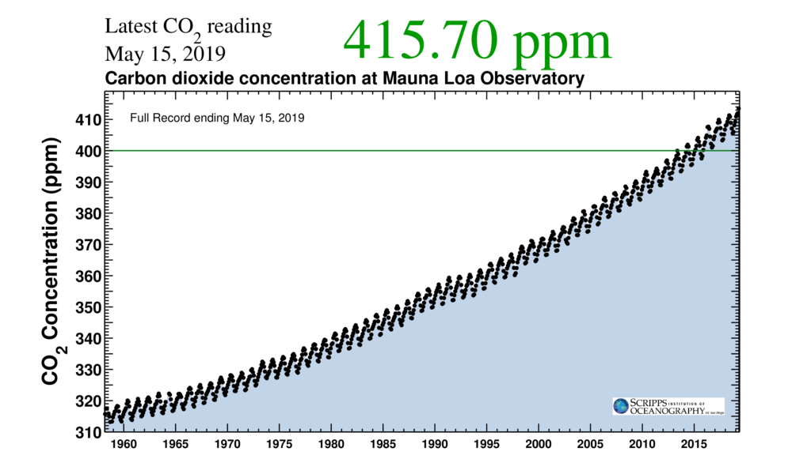
No “new normal” in sight

Slide 10
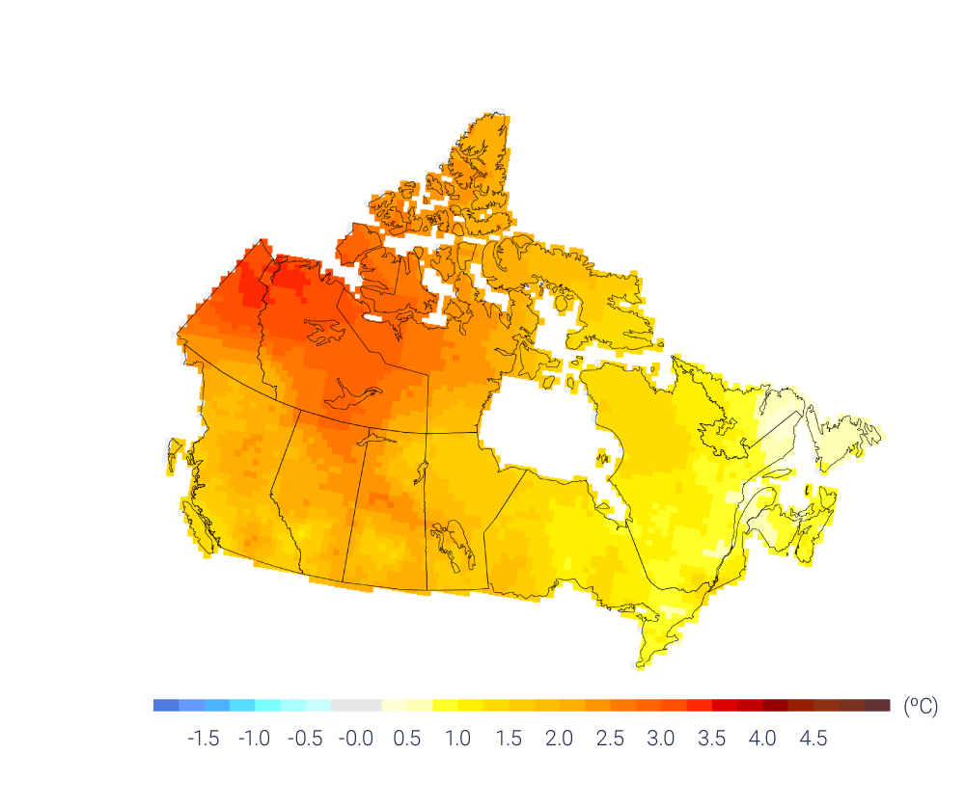
Canada Heating Twice as fast as Global Average
Annual temperature 1948 - 2016
Notes:
https://changingclimate.ca/CCCR2019/graphics/

Slide 11
Cities are Hotter
7.6ºC (dark blue) to 10.8ºC (dark red)
Toronto Annual temperatures 1841-2017
Source: National Centre for Atmospheric Science

Slide 12
Winter is Wetter
Average change
per decade
1979-2016
12
Source: Prepared by LAMPS York University.

Slide 13
4 x climate extremes
Source: Canadian Institute of Actuaries
13

Slide 14
So what?

Slide 15
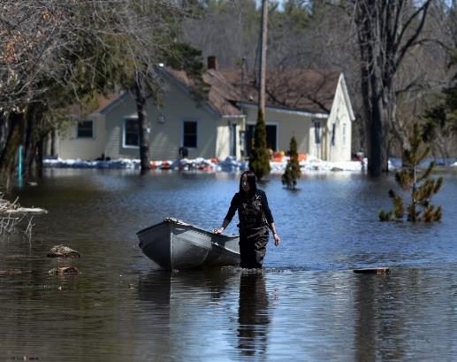
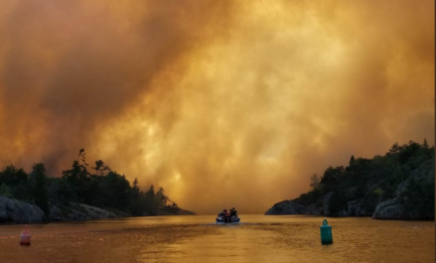
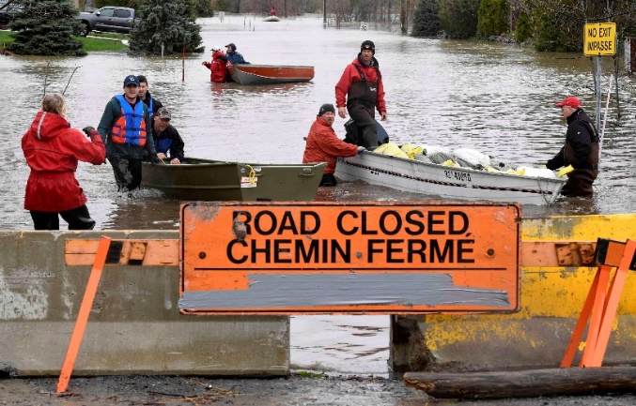
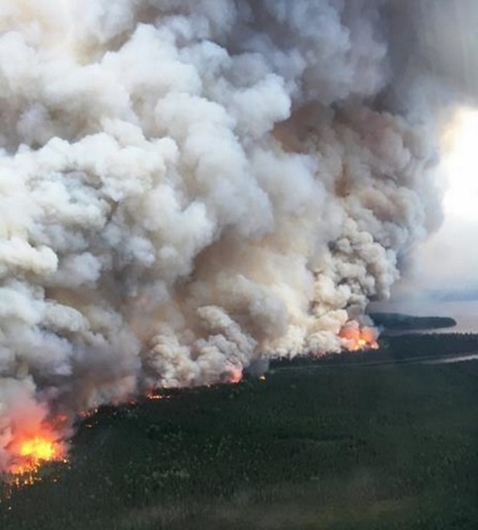
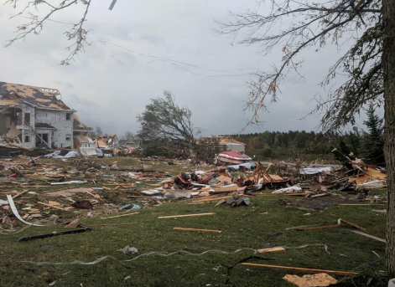
So what?
Accelerating change
Hotter, weirder, wackier weather
Physical damage
Food instability
Economic Loss
Physical and mental health
Conflict, inequality, migration

Slide 16
16

Slide 17
How close to 1.5°?
We’re almost there
Our house is on fire

Slide 18
If Avoid unmanageable, Can manage unavoidable
Mitigation
Adaptation
reduce emissions of pollutants (GHGs) that cause climate change
cope with the impacts that have already occurred and will occur as a result of climate change

Slide 19
Opportunities too Major co-benefits of reducing reliance on fossil fuels
Reduced Reliance on Fossil Fuels
Economic Growth
Energy Resilience
Environmental Sustainability
Lower Energy Bills
Human Health
Competitive
Businesses
Government
Source: ECO

Slide 20
What’s holding us back?
Fossil fuels are cheap
When pollution is free, we get more of it
Burning fossil fuel seems cheap, safe, convenient

Slide 21
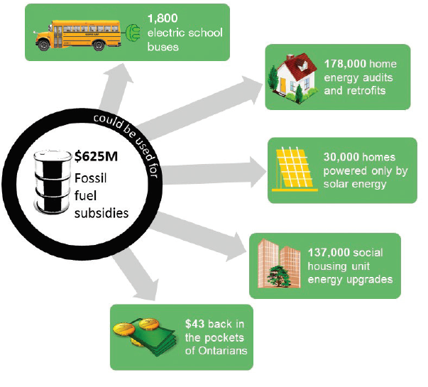
Why are fossil fuels so cheap?
Huge tax breaks /subsidies
A century of innovation and investment
Immense political and economic power
Private profits, public costs
Sources: Ontario Ministry of Finance, Ontario Ministry of the Environment, Conservation and Parks, Union Gas, Ontario Solar Installers
21

Slide 22
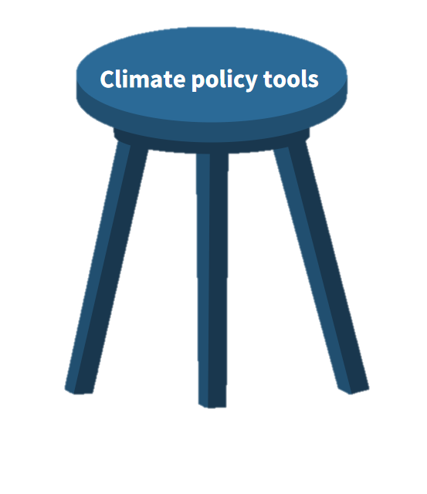
Why a Carbon price?
Nobel Prize in Economics
It levels the playing field
It rewards innovation
It funds solutions
Making polluters pay
Regulating polluters
Investing in solutions

Slide 23
When government puts a price on pollution
Polluters innovate to reduce costs
Continuous improvement
Reduce pollution, → cost savings
Pollution costs polluters money
reinvest
New jobs to design and implement solutions

Slide 24
2. How Carbon price works

Slide 25
Prices influence behaviour
People buy less fossil fuel when it costs more
Market won’t put prices up, because of huge potential supply
Only gov’t action can durably increase price

Slide 26
Key Design questions
Source of funds:
Who pays?
Determined how?
E.g. cap and trade or carbon price
Use of funds:
Mitigation?
Adaptation?
Reduce other taxes?
Public dividend?

Slide 27
We used to think…
Carbon Tax:
Gov’t sets price
Simpler to understand
Cap and Trade:
Gov’t sets cap
Doesn’t include the word tax
Lower cost GHG mitigation
Faster to implement

Slide 28
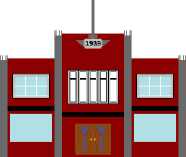
Ontario Cap and Trade was working
2
Carbon Pricing
Revenues
1
Cap & Trade
3
Energy Efficiency
Improvements
CAP
High-Carbon Ontario
4
Low-Carbon Ontario
28

Slide 29
Raised billions for low-carbon initiatives
Cap and Trade raised $2.9B
$1.9B was spent on programs to reduce GHG emissions
74% → public services (hospitals, schools, social housing and municipalities)
19,000 social housing units received energy efficiency upgrades
Energy retrofits at 98 hospitals, 621 schools, 48 universities and colleges
129 municipalities received funds for transit, waste, energy efficiency and cycling infrastructure
$4 invested by industry for every $1 in Cap & Trade funding
29

Slide 30
How has it worked?
Notes:
Pembina, https://www.pembina.org/op-ed/carbon-pricing-economic-growth

Slide 31
Carbon pricing in thriving economies
BC’s carbon tax has reduced GHG emissions 5% -15%
California’s cap-and-trade system is reducing emissions — and the economy is thriving
UK has rapidly reduced its emissions with a hybrid carbon-pricing system

Slide 32
But now: a wrenching halt
Despite Nobel Prize
All serious Ontario programs cancelled, including cap and trade, renewable energy contracts
Conservation slashed
No meaningful replacements
Weak targets, little action
Where are we now?
Ontario is sitting on its hands, or worse.
32

Slide 33
Which triggered the Federal Carbon PRice
1 of 4 pillars in Pan Canadian Framework:
Pricing Carbon Pollution
Complementary Actions to Reduce Emissions
Adaptation and Climate Resilience
Clean Technology, Innovation, and Jobs
Federal backstop
Greenhouse Gas Pollution Pricing Act

Slide 34
Greenhouse Gas Pollution Pricing Act
Upheld by Saskatchewan and Ontario Courts of Appeal
SCC appeal: January 14, 2020
Alberta reference pending

Slide 35
Not a “Tax”: No revenue to government
Source of funds:
Use of funds:
Large polluters
10% for reducing emissions
Large polluters
Fuel tax
90% back to households through income tax

Slide 36
WHO PAYS? Who Wins?
Cap and trade:
Households: - $450 MM
LFE +$290 MM
BPS: - $43 MM
Other business - $138 MM
Federal carbon price*
Households: + $728 MM
LFE -$108 MM
BPS: -$251 MM
Other business - $583 MM
Estimates for 2022 in Ontario

Slide 37
Paying more for LESS
2022 estimates. EnviroEconomics

Slide 38
Why does it work if I get it back?
Carbon dividend:
Extra 10% for rural, remote
Carbon fee:
80% of households get more than they pay
Use less, pay less
Use for whatever you want
Every person gets $ / year, in advance
Pay when you use fossil fuels

Slide 39
Misleading the public
Most families will end up ahead
Choice: can reduce fossil fuel use
Where does the money come from? SME, institutions

Slide 40
Output Based Pricing System For large polluters
A lot like cap and trade
For large emitters (over 50kt)
Emitters over 10Kt can opt in
If there’s an appropriate benchmark
Sector-specific standards
% of production-weighted national average of emission intensity, increasing with time
Facilities that meet the benchmark do not pay; facilities that perform better get credits
Facilities below the benchmark must:
Pay a fixed levy
Submit surplus credits (banking/ trading), or
Use offsets

Slide 41
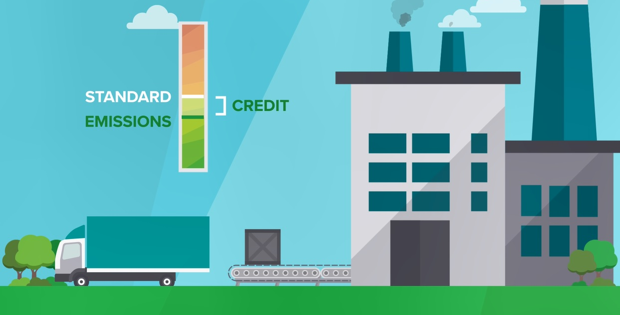

Slide 42
Where will the money go?
If levy (comes to gov’t), back to large emitters in the same province for reductions
If surplus credits, back to low-emission industry
If offsets, back to ?

Slide 43
3. Carbon pricing isn’t enough

Slide 44
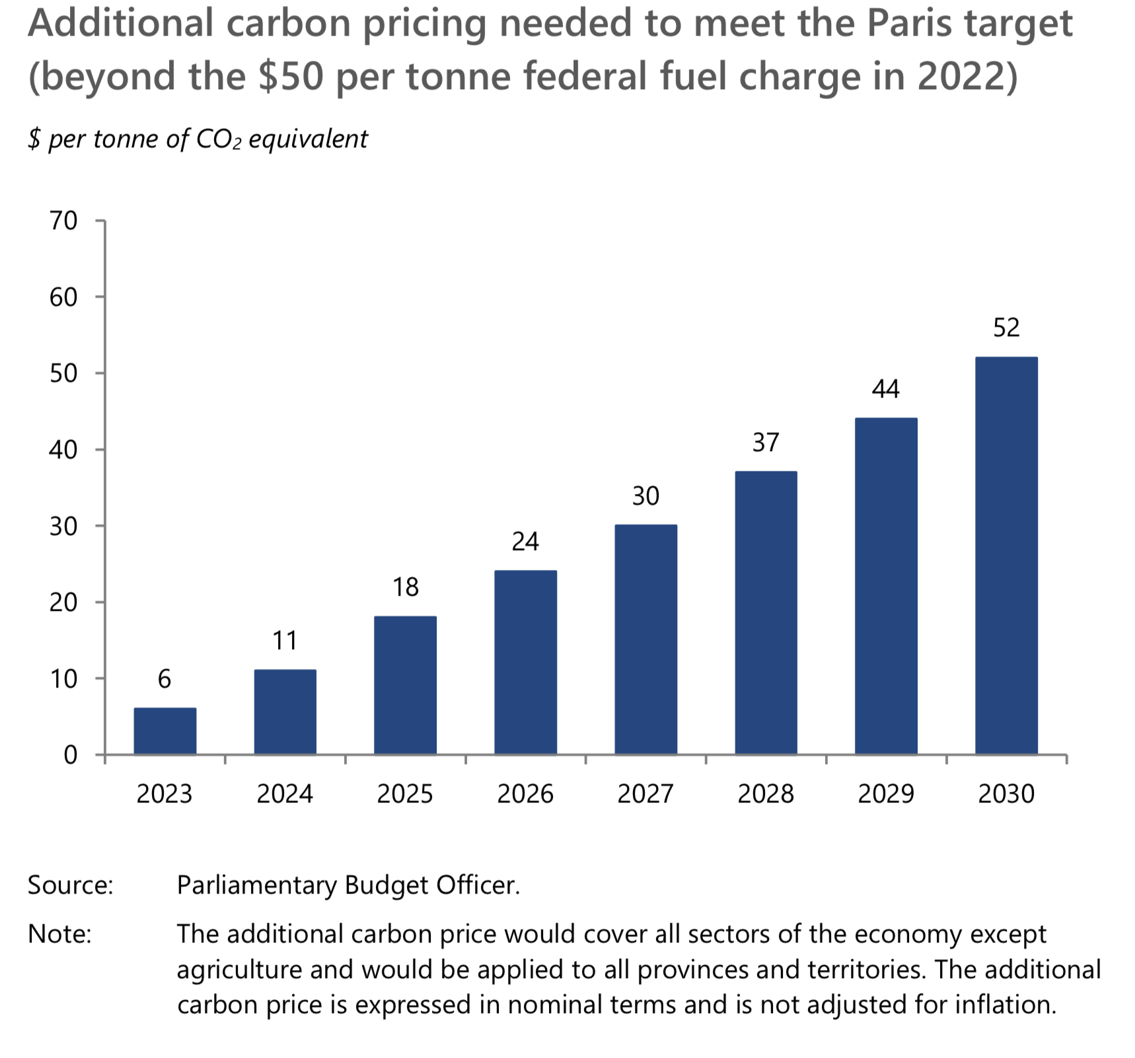
Price is too low
Predictable, gradual price rise essential for meaningful reductions
Per PBO, price must keep rising to $102 (2030)

Slide 45
gaps in the Price
Examples:
Agriculture
Methane
Soot
Refrigerants, Anaesthetics
What can help?
Gap fillers,
E.g methane regulation
Signal boosters
To reduce obstacles such as incomplete info, split incentives
Benefit expanders
E.g. reducing toxic air pollution

Slide 46
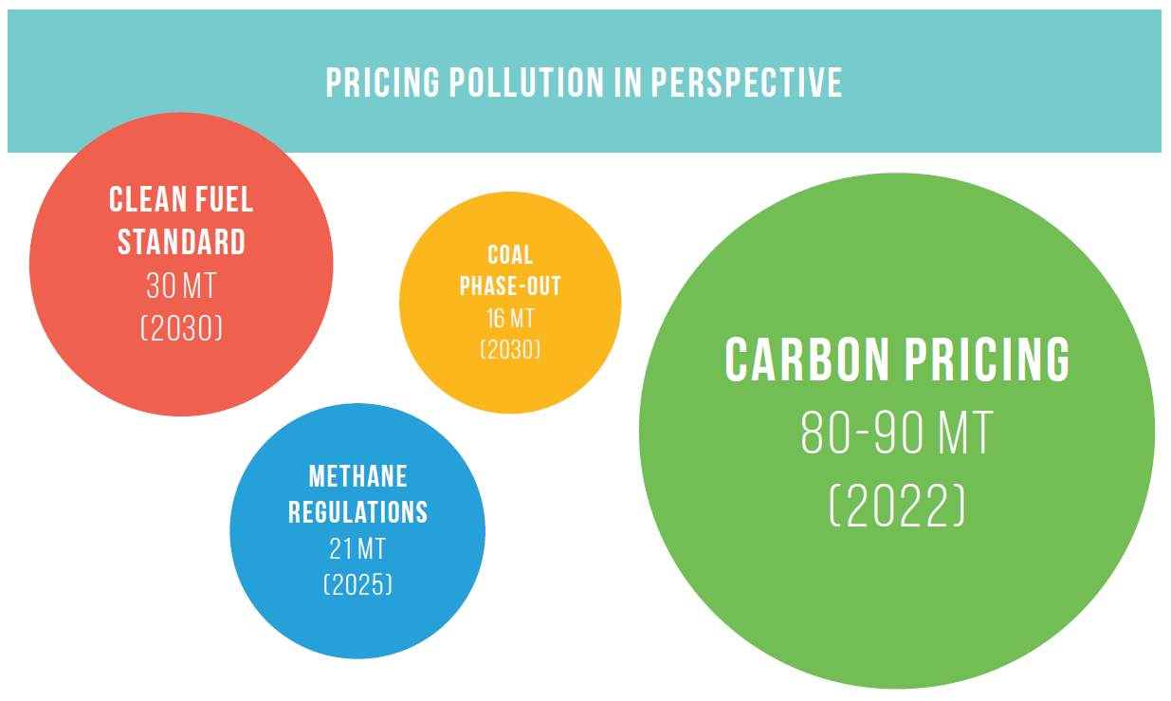
Pricing is Only part of Pan Canadian Framework
50 - 60

Slide 47
Pillar 2:
Complementary actions to reduce emissions

Slide 48
carbon pricing v. regulations
Best for the economy
Encourages continuing innovation
Can fund other initiatives
(Maybe) best for politics
Encourages compliance
Can work well for some specific problems when the right answer is clear

Slide 49
carbon pricing v. regulations
Emitters are not all the same. Carbon pricing takes advantage of these differences to minimize the cost of reducing emissions and to give people and businesses flexibility
Regulations can do things pricing can’t, usually at a higher, less visible price

Slide 50
Plus 2 more PCF pillars
1 of 4 pillars in Pan Canadian Framework:
Pricing Carbon Pollution
Complementary Actions to Reduce Emissions
Adaptation and Climate Resilience
Clean Technology, Innovation, and Jobs

Slide 51
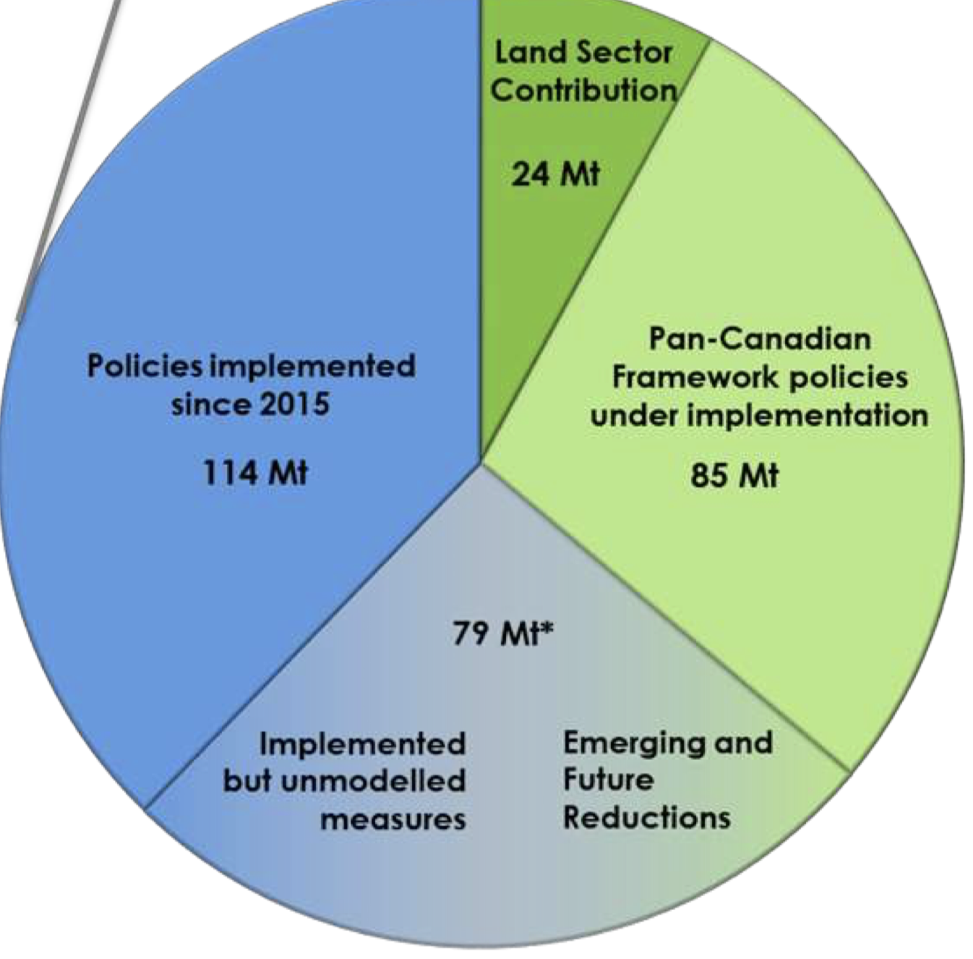
But:
Pan Canadian framework won’t reach our current Paris Commitment

Slide 53
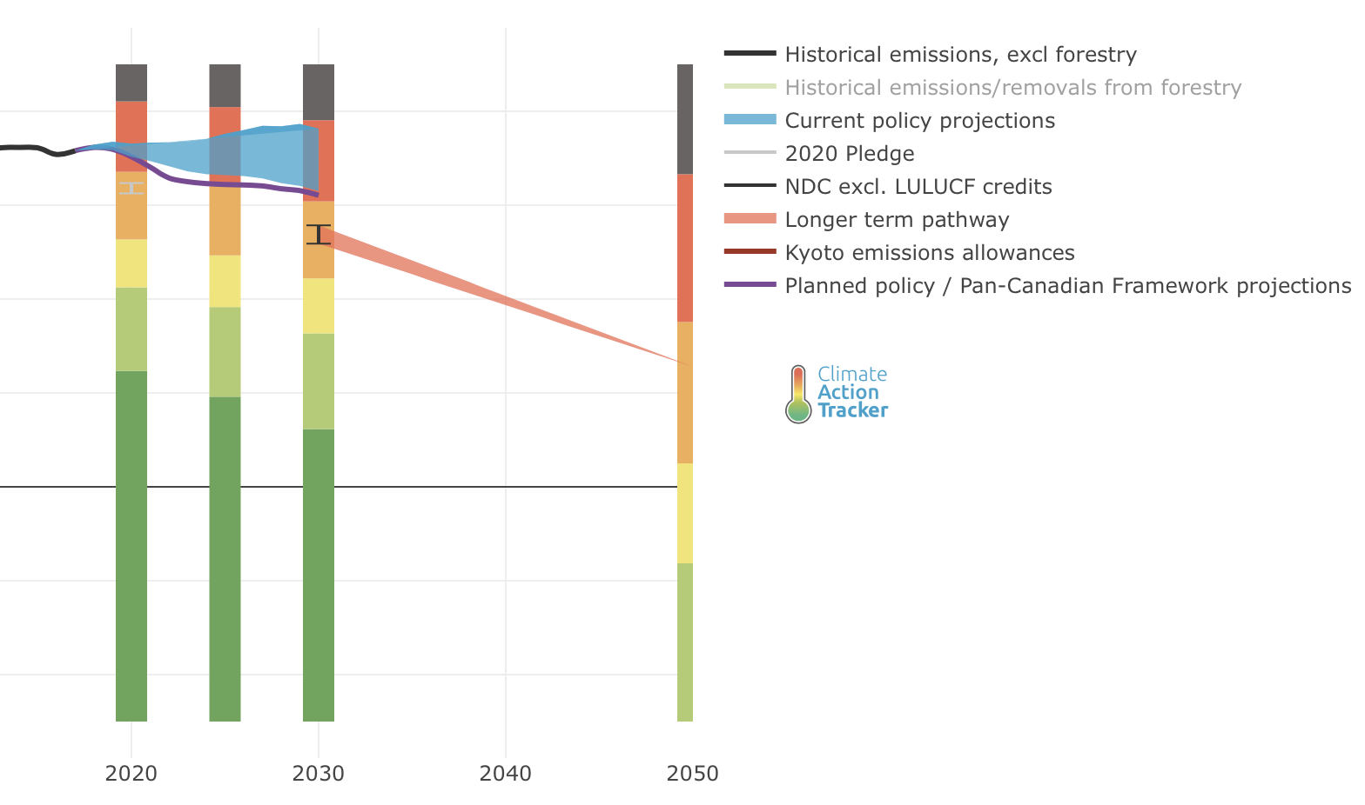
Canada’s Current Paris Commitment ≠ 2° or 1.5° future

Slide 54
If we want a 1.5° world
1.5° world: Less stable and safe than today, but manageable
We can only emit:
~55% of 2010 GHGs by 2030
Net 0% GHGs by ~2050

Slide 55
If we want a 2° world
2° world: Much less stable and safe than today, major economic damage but survivable for most
We can only emit:
~75% of 2010 GHGs by 2030
Net 0% of 2010 GHGs by ~2070

Slide 56
Is it too late?
We are in for big changes
There is still a little time to avoid the worst
Our choices, right now, matter
56

Slide 57
What can I do?
Climate cannot be left entirely up to government
Reduce your carbon footprint
Speak up
Get ready to adapt
57

Slide 58
Speak up how?
Simple clear messages, repeated often, by a variety of trusted voices.
58

Slide 59
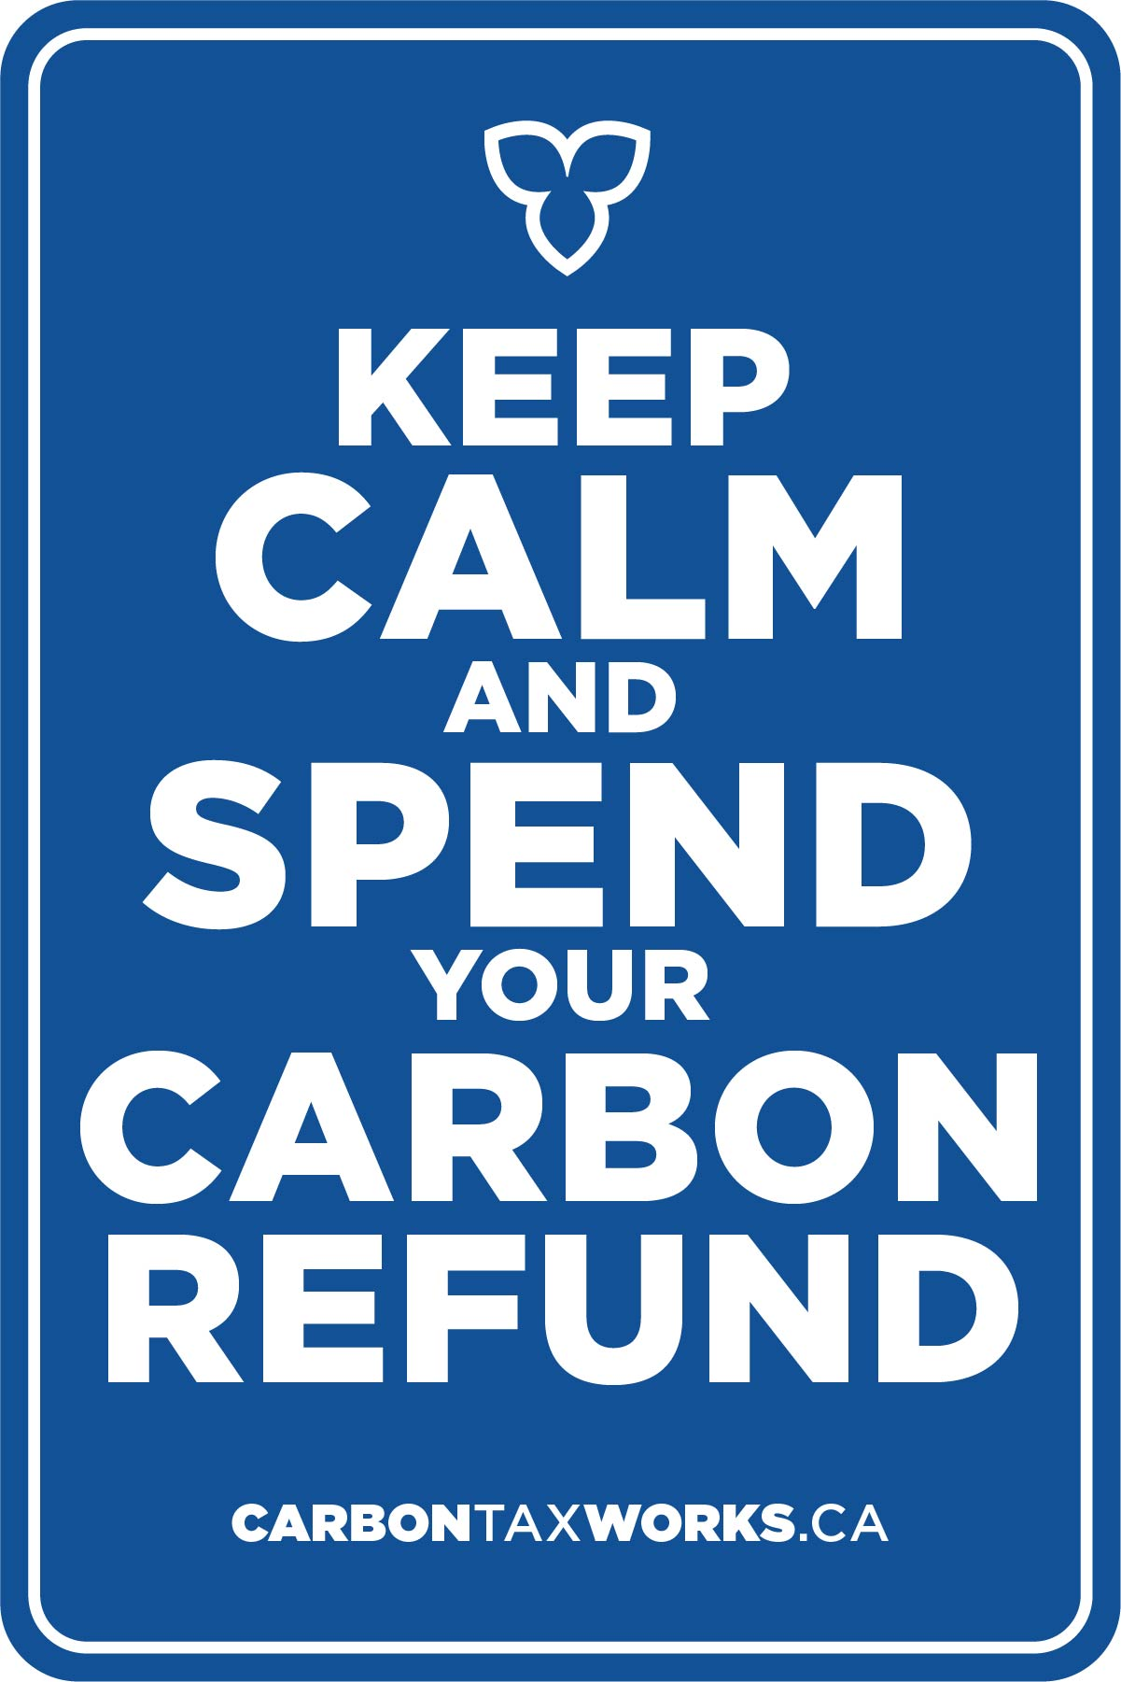
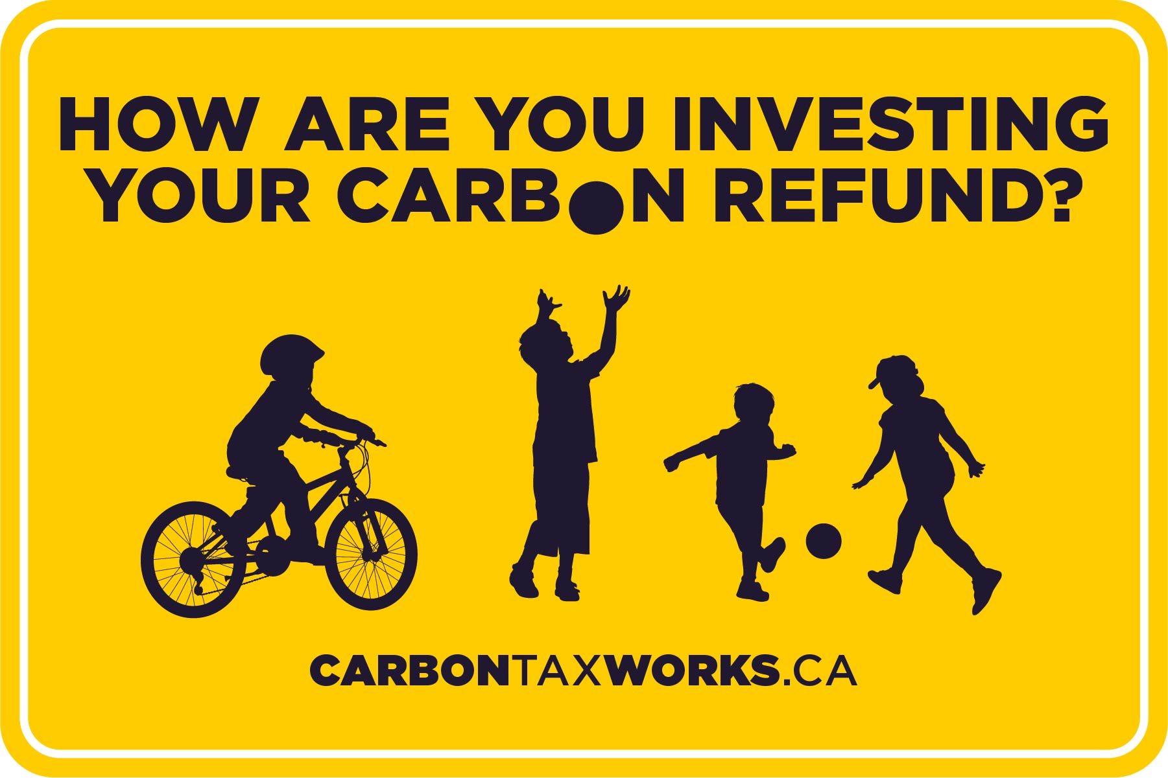

Slide 60
3 to speak up ABOUT:
Price Climate Pollution
Stop Sprawl
Protect Nature
60

Slide 61
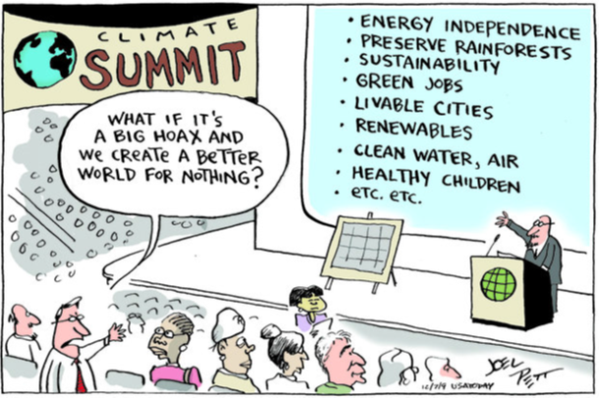
61

Slide 62
Thank you
Dianne Saxe
SaxeFacts.com
dsaxe@saxefacts.com
@envirolaw1

