Slide 1
EVs:
The Grid
Life Cycle GHGs

Slide 2
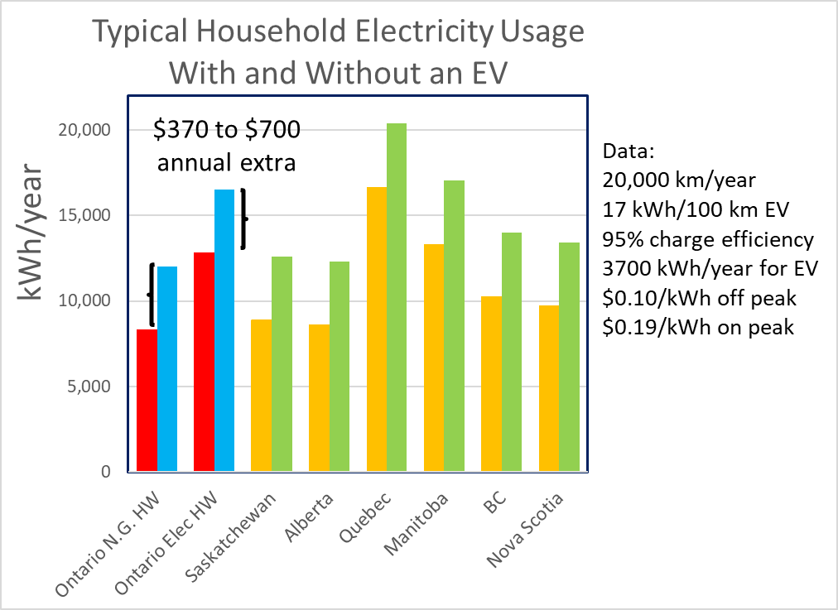

Slide 3
11 M EVs
By 2050
+40 to 60
TWh
3 M EVs
By 2030
+10 TWh
(Stats Can, IESO and Ontario Hydro, Lapp)

Slide 4
Manufacturing and Life Cycle
GHG Emissions

Slide 5
220,000 km vehicle life
Car made in USA
(i.e. coal intense)
50 tons of GHG due to gasoline usage
Ontario electricity
Worst case larger 62 kWh battery
Ontario electricity
160 km Battery
Base data from 2015
Union of Concerned Scientists – Cradle to Grave, includes upstream fuel production emissions

Slide 6
Thanks!
lappstve@kos.net

