Slide 1
Buying an EV in Quebec
And Installing a Charger…

Slide 2
Why Quebec?
Federal and provincial rebates total $12,000 on new EV’s
This tends to reduce the price of used EV’s
There are a lot of EV’s on the road in Quebec, so there are also more for sale used.

Slide 3
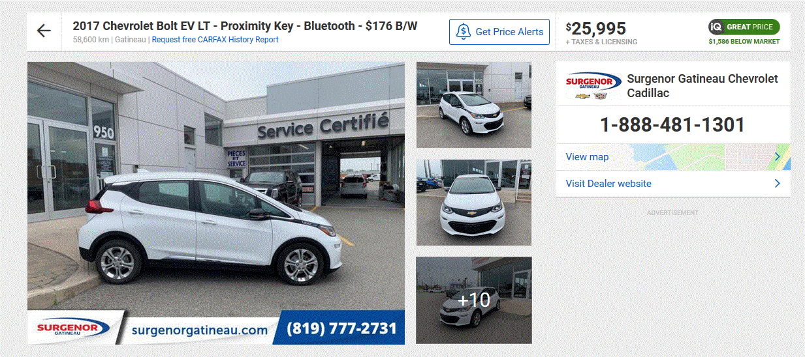
58,600 km

Slide 4
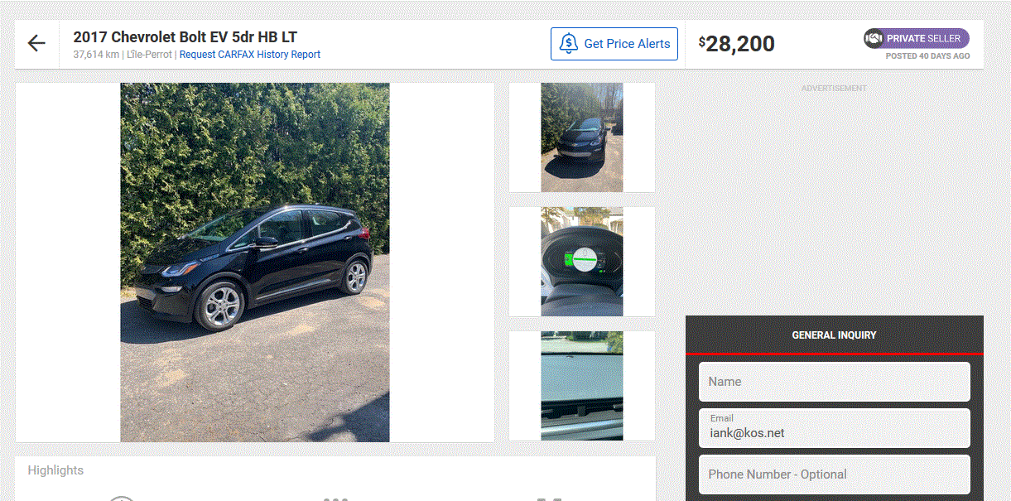
37,614 km

Slide 5
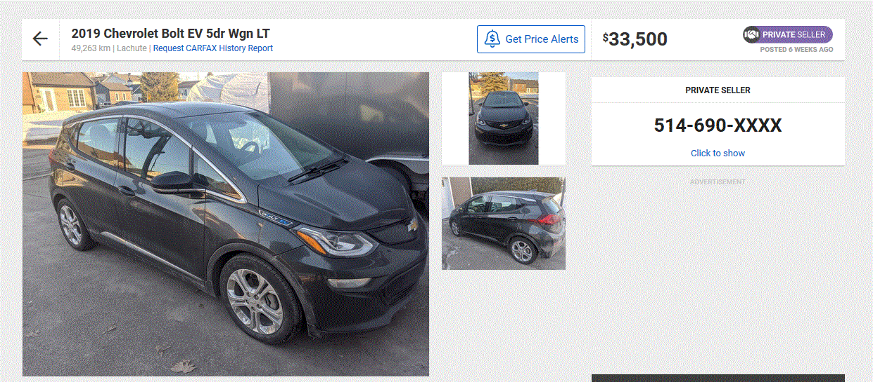
49,263 km

Slide 6
The Rule:
A Quebec EV has to be licensed on the road for at least one year before it can be sold used. This prevents quick ‘flipping’ of cars out of province.
Unknown: how is this rule enforced? If sold earlier, probably somebody has to pay back the rebate…

Slide 7
Licensing
Dealers in Quebec can issue a transfer permit that you post in the back window instead of a license plate. This is a Quebec government document, but the dealers can issue them without going to a license office.
With your transfer permit, you can drive the car home to Ontario.
With the VIN# for the car, you can get insurance even though it is not licensed yet
To get an Ontario license plate you need to get the car safety checked by an Ontario mechanic (I paid $100 tax included).
Private sale in Gatineau: try to have the owner drive the car to a license office in Ottawa, where you close the deal in the parking lot. You then go in and get a temporary Ontario permit that allows you to drive the car until you get the safety done.
Private sale far from the border (like Montreal) I’m not exactly sure.
Get a temp permit from a Quebec license office?
Get a temp permit from Ontario, but you need the ownership document to do this.
Put any Ontario plate on the car in Quebec and drive it home (risk a fine if you get stopped for some reason). But get it insured for sure…

Slide 8
Sales Tax
Scenario 1
My Gatineau dealer also has an Ottawa store and so they charged me Ontario tax when I bought the car. At the license office, the bill of sale proved this, and I was not charged Ontario tax again.
Scenario 2
The Quebec dealer charges no tax. You will pay Ontario sales tax when you get a license plate, based on the value of the car as shown on the bill of sale
Scenario 3 Private Sale
You get a written bill of sale from the seller showing the price paid and the ownership slip, signed over to you. You will pay Ontario tax when you license the vehicle.
Scenario 4 (yuk)
You get charged Quebec tax by a Quebec dealer and then later get a refund somehow, upon proving that the car was exported out of Quebec.

Slide 9
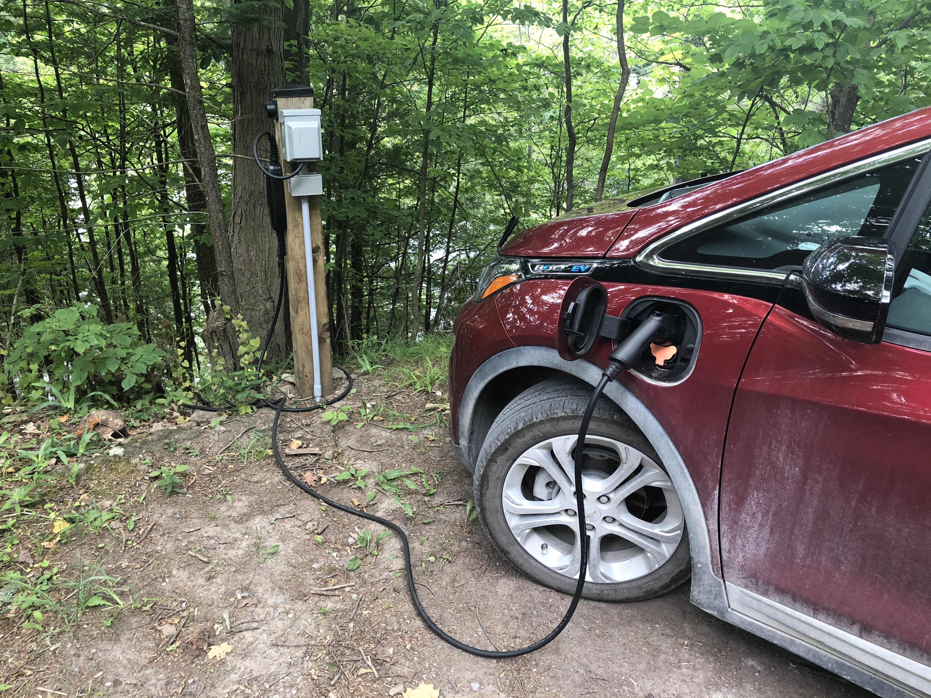
My Charger

Slide 10
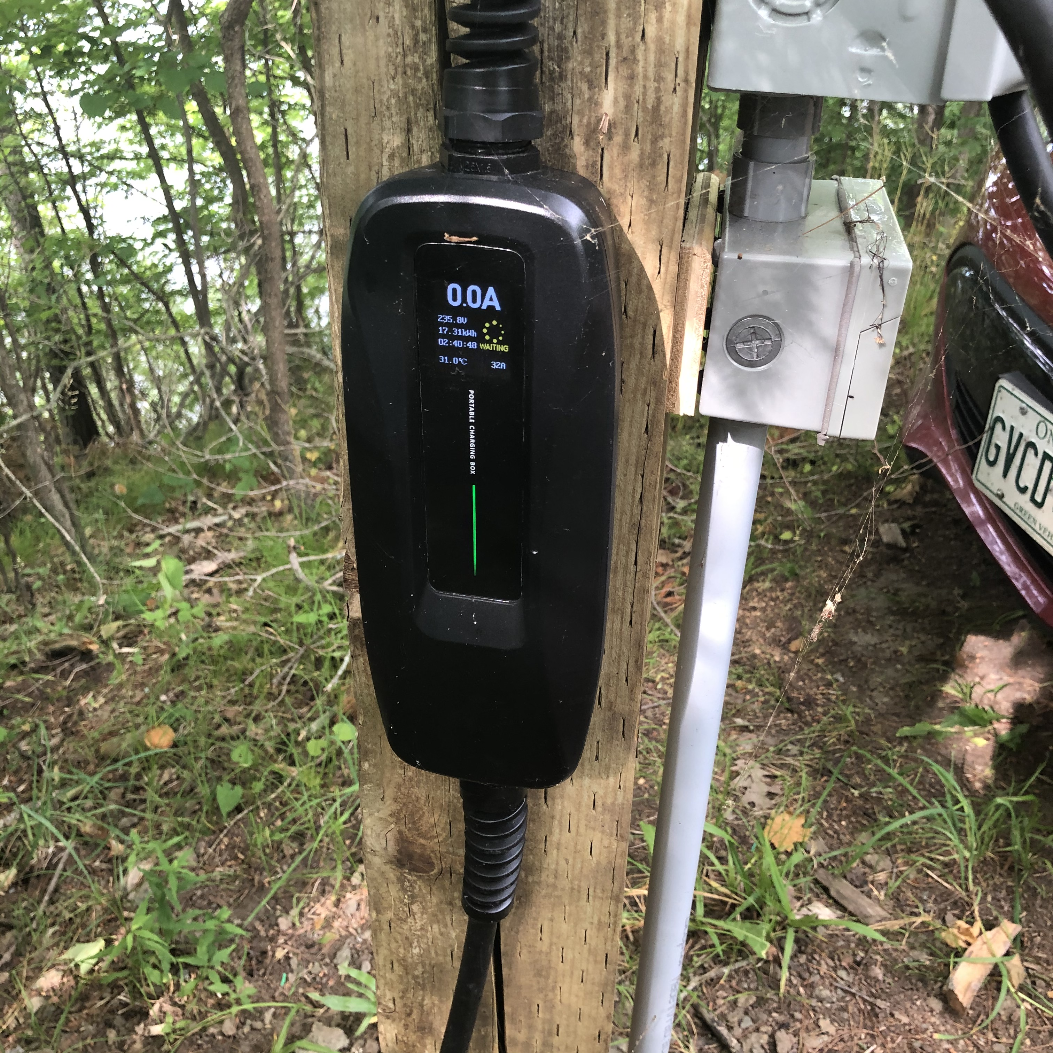
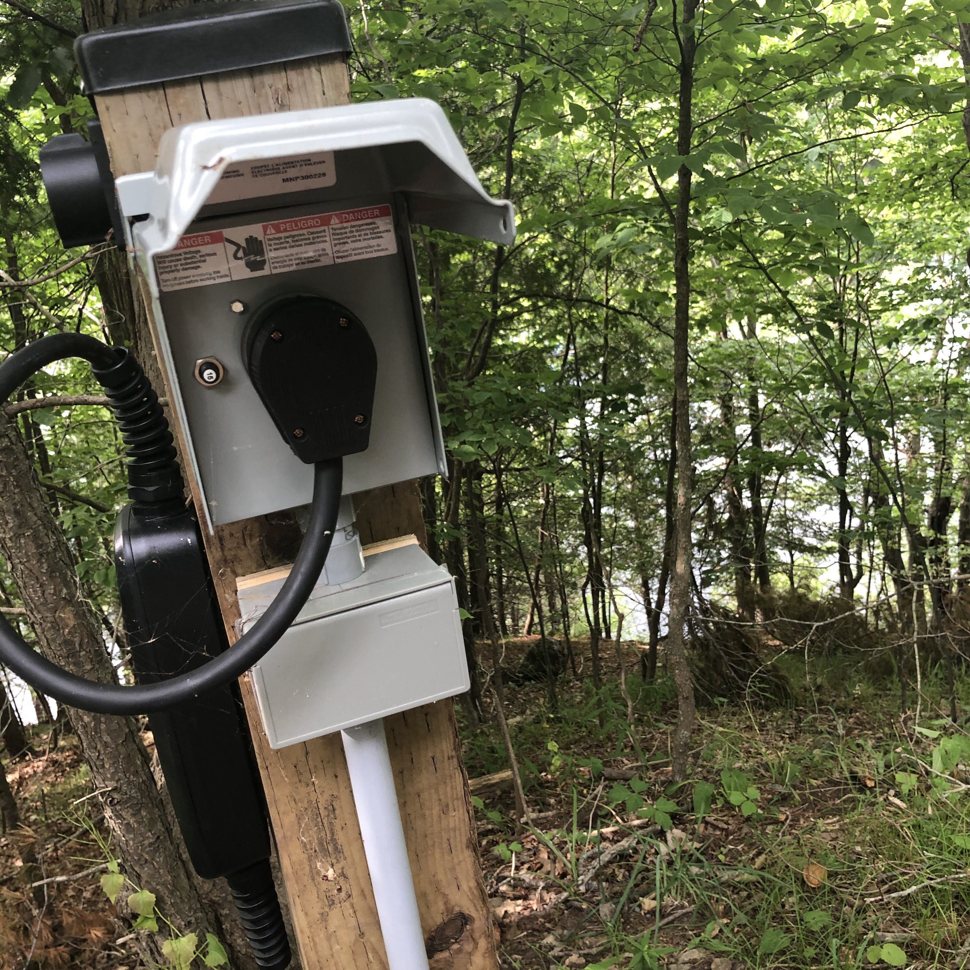

Slide 11
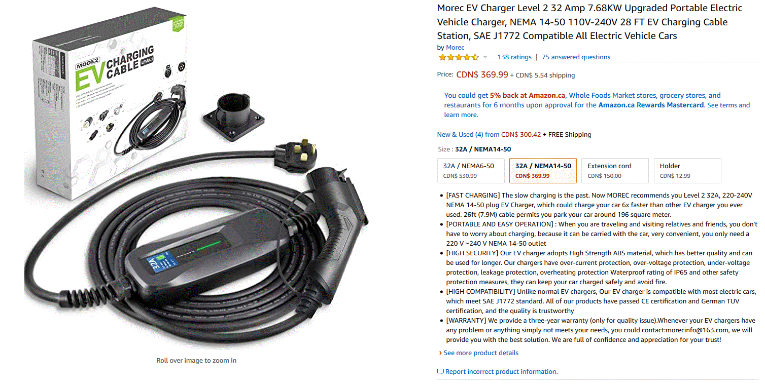

Slide 12
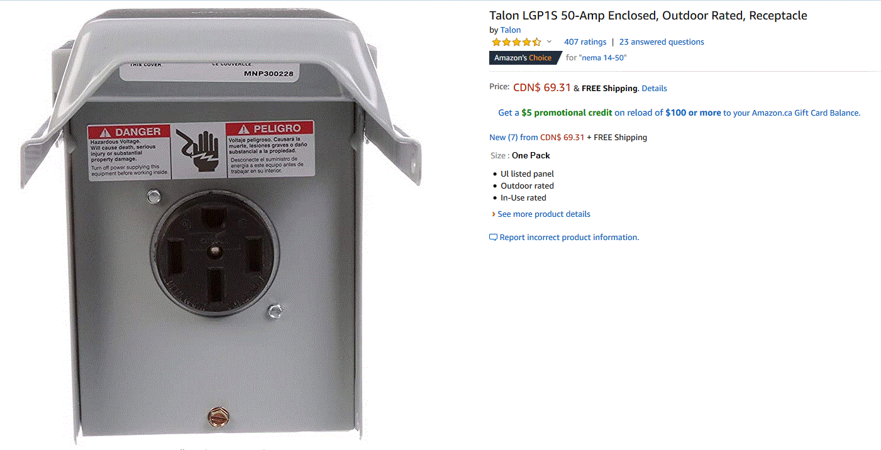

Slide 13
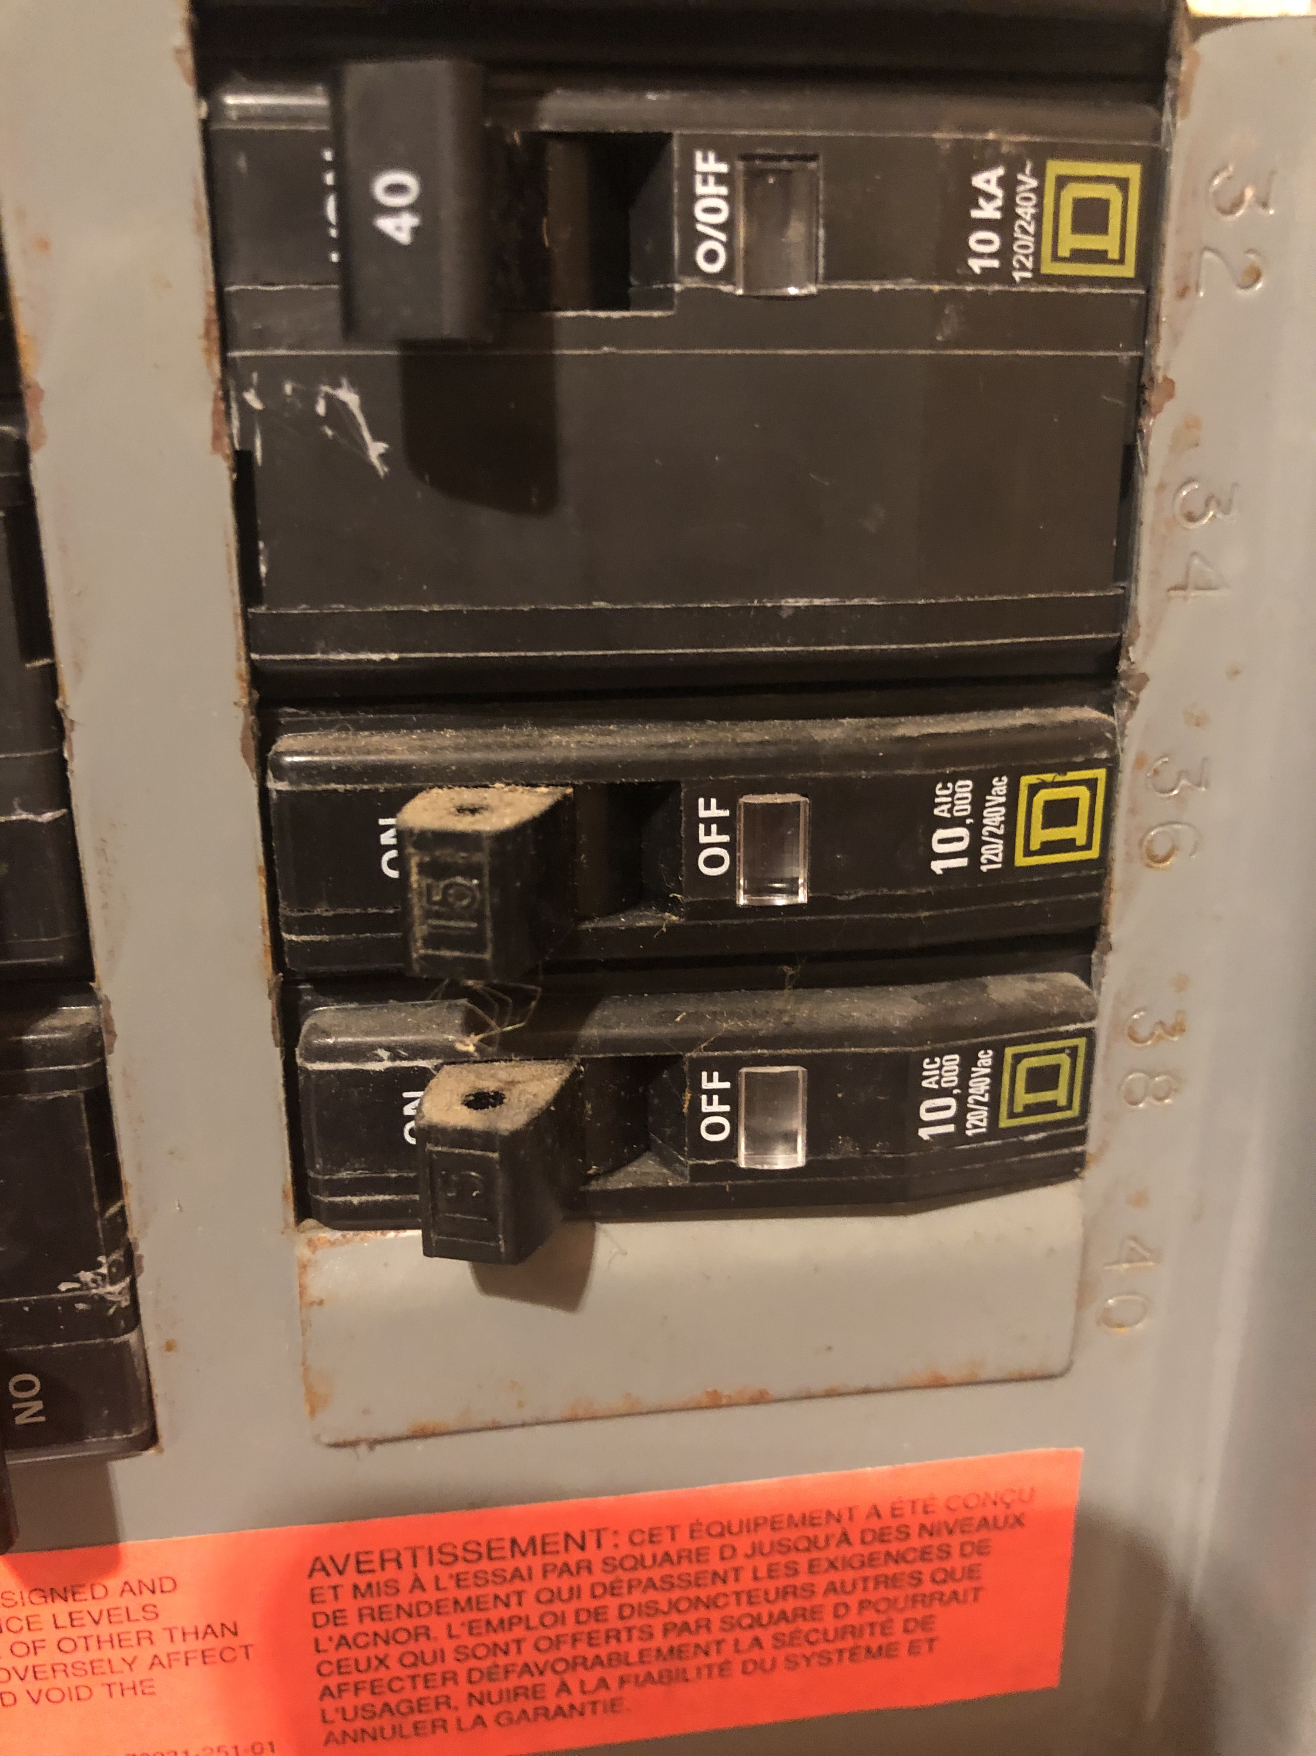
40 A circuit breaker Hopefully you don’t need a service upgrade…

