Slide 1
Managing Energy Costs
Making it less complicated for people to understand renewable energy
Notes:
5 years in the business; attended Home shows, farm shows, common problem is people have not been looking at their energy bills , they just pay them some by direct payment out of their current account….many say they are too busy working to make the money to pay the bills; don’t have time to think BUT lately it has changed to anger at the cost in creases they are seeing. They are looking for someone to blame and thjey cannot touch Hydro one, but they can show their distrust when they vote.

Slide 2
Establish what the client has already done
R Values : insulation in basement, building walls and attic.
Windows: double OR triple glazing of windows.
Air Leaks: caulking around all windows , doors etc.
Lighting : conversion of all lighting to LED
Efficiency of appliances: fridges / freezers; clothes driers etc.
Efficiency of water heater and furnace
Age of the Property:
Homes over 50 years : many need significant upgrade – all of the above
Homes 20 -50 : need incremental upgrading on many of above.
Homes 10 – 20 : need to look closely at appliance efficiencies
Homes < 10 : LED lighting ; start monitoring and measuring all electrical units.
Notes:
Comment on fridge usage 700kw/yr; replacement of old furnaces ; replacement of water heaters.

Slide 3
Investment in Solar Energy
Harnessing Power of Sun :
Thermal energy transfer to heat AIR ……………. 50% Efficient
Thermal energy transfer to heat WATER……….. 60% Efficient
Converting light energy to electricity …… ……… 20 + % Efficient
Home air heating - Solar Sheet heating …………start at $1500
Solar Thermal Domestics Water Heating ……….start at $6000
Solar PV Electricity generation (serious)………..start at $15,000
Notes:
Our Gvt says that close to 65% of energy usage in the average Cdn home is consumed for AIR and Water heating. As much as 30% for water.

Slide 4
Solar Thermal Air Heating

Slide 6
Solar Thermal Air Heating

Slide 7
Solar Thermal Air Heating
Notes:
Depending upon the size of the installation, Solar sheet panels can capture up to 14 BTUs /day

Slide 8
Solar Thermal Domestic Water Heating

Slide 9
Solar Thermal Domestic Water Heating
Sizing of the System
family size…….1panel or 2 panels
heating domestic hot water only
heating water also for home heating
Sq.footage of the home and type of hydronics system installed or going to be installed.
can be retrofitted to heat swimming pools and hot tubs.
Systems as large as 40 panels installed on hi-rise buildings.

Slide 10
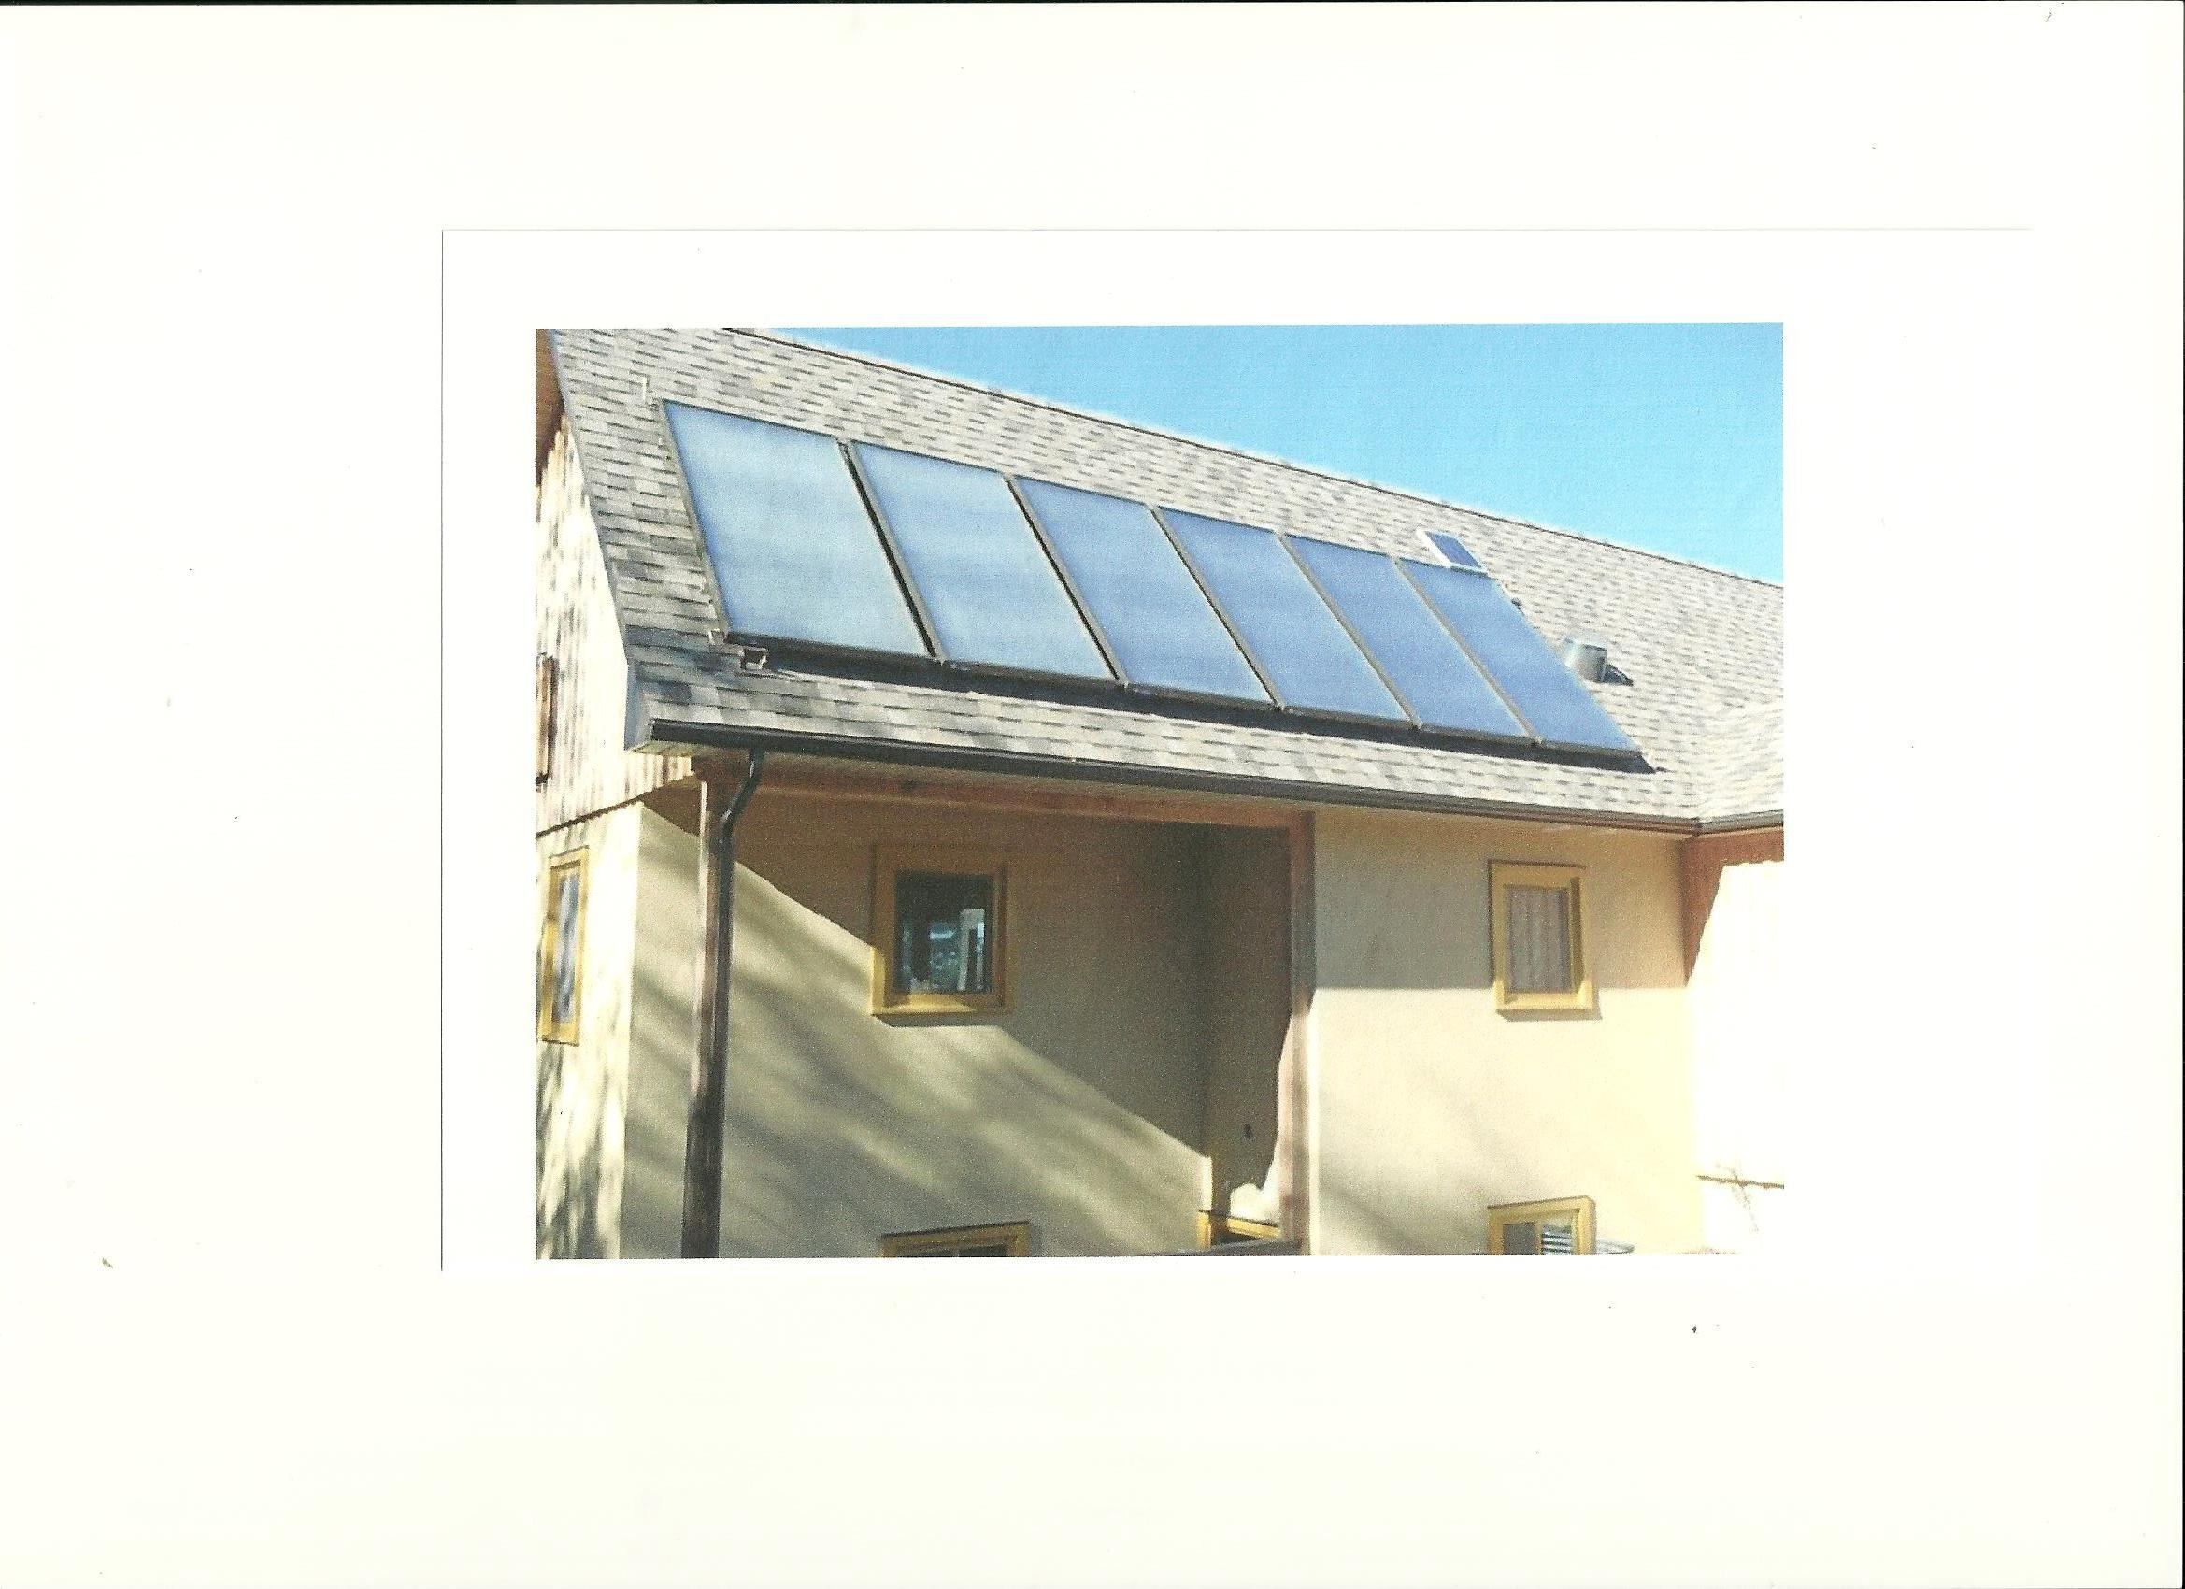

Slide 11
Solar Thermal Domestic Water Heating ( example of 2 person family –detached 1500 SqFt home)
Notes:
Total reduction over 6 winter mths, Nov to April 1,400kWh ; more sun in Summer so 3,000kWh rating is achieved with 2 people

Slide 13
The SB64-9PV has the highest Energy Rating of all CSA certified systems in Canada

Slide 14
Solar Thermal Water Heating
Ontario Provincial Government
SaveOnEnergy Program
For Single Family Residential Home Owners, INCENTIVES for investing in Solar Thermal Hot Water Heating ceased in 2014. It continued for commercial, small business, agriculture, and Multi-Family buildings like Apartments /Condos.
Why is it not still going……….when close to 30% of households in Ontario heat domestic hot water with electricity.
Even 30% of 30% making a reduction of 30% in their consumption of electricity would a sizeably demand reduction in electricity in the province.

Slide 15
Self Generation of Electricity
Current population feelings across Ontario
How can I get off the grid ?
Or how can I reduce my Hydro bill ?
Where do I start ?
First thing is to rate and document every electrical load in the home or business.

Slide 16
Measuring and Logging the Electrical Loads.

Slide 17
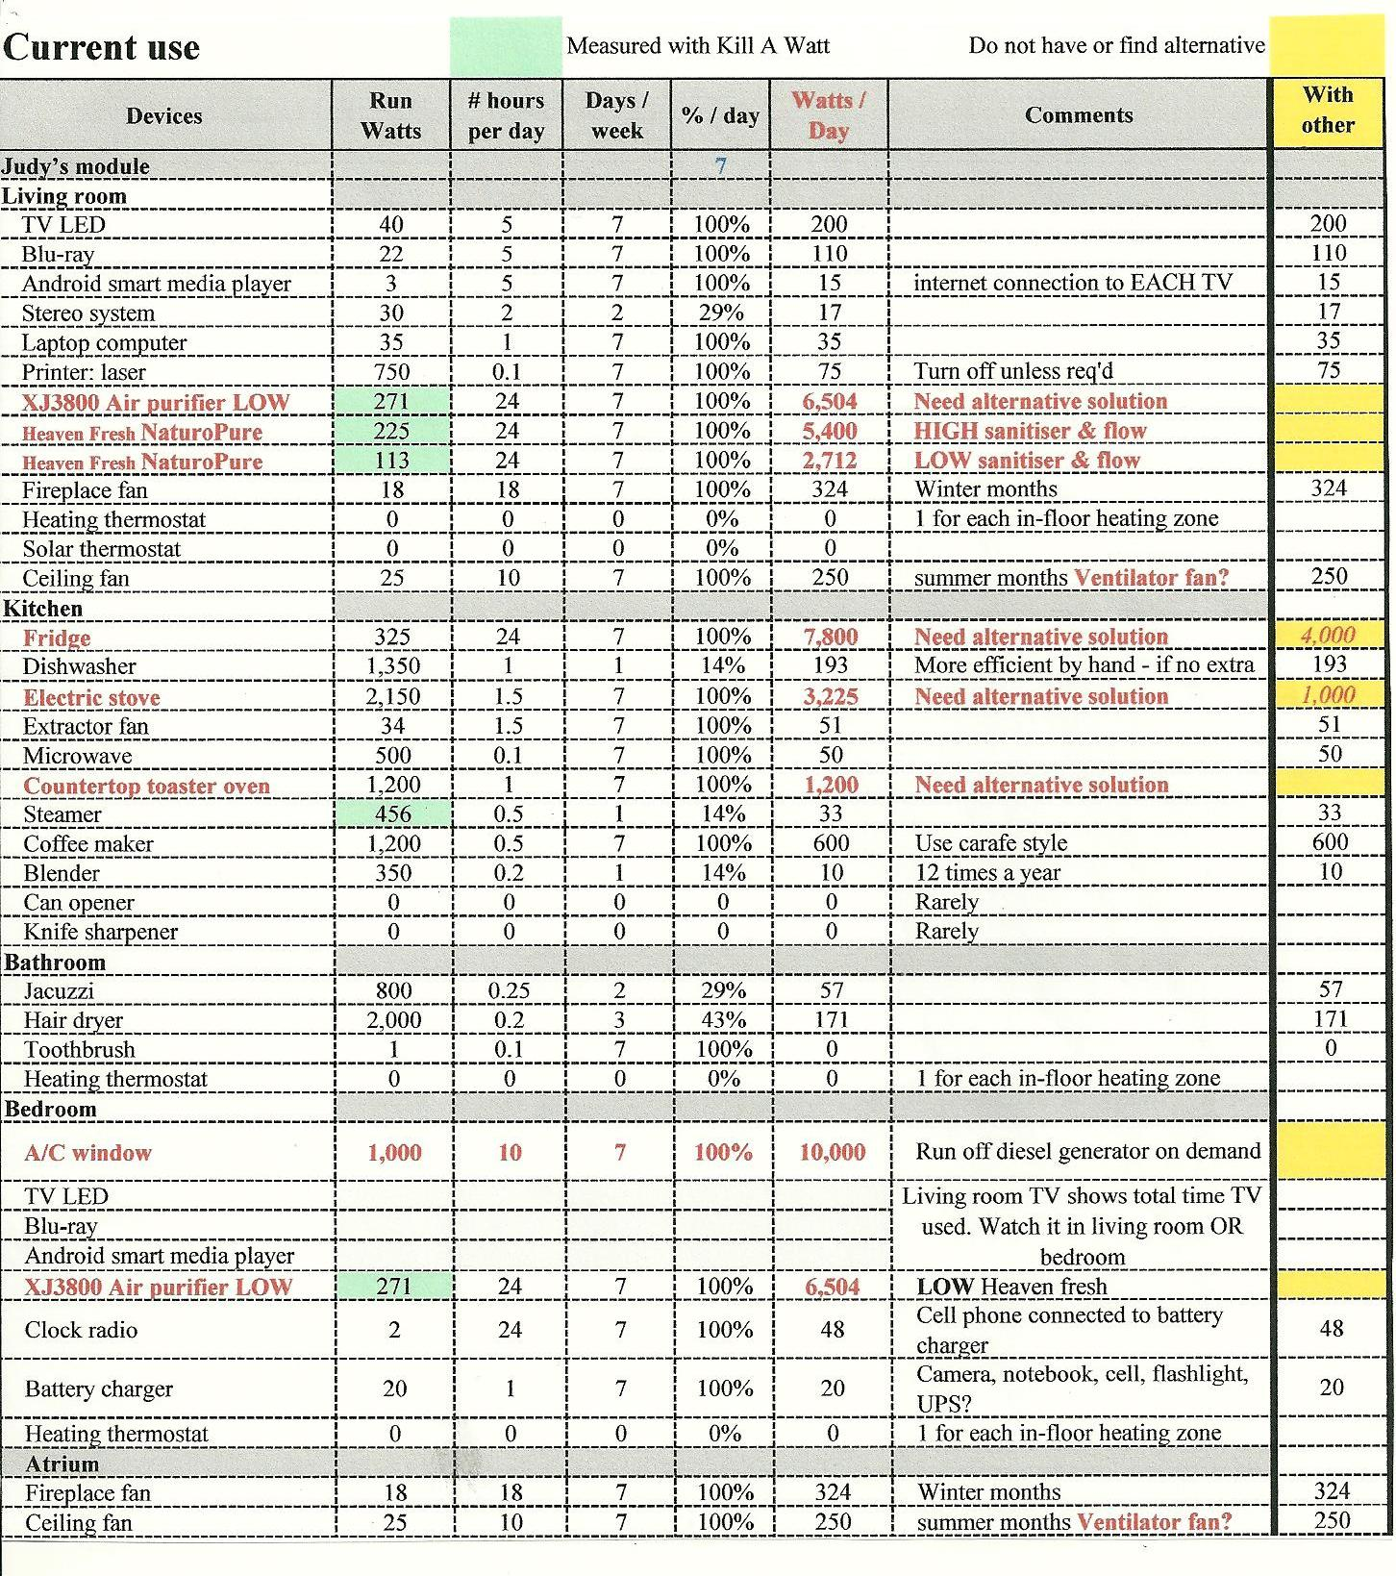

Slide 18
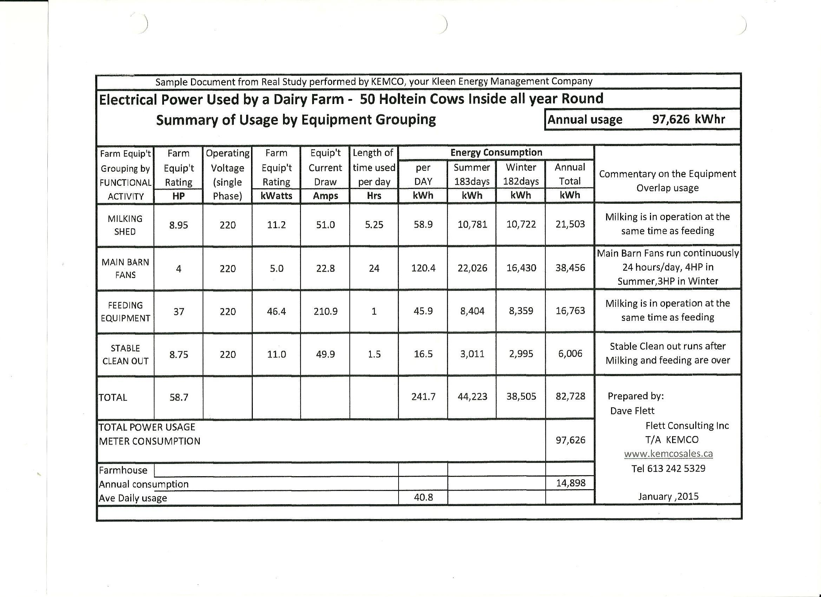

Slide 19
Self Generation of Electricity “Before you Generate, you have to Educate”
Pay attention to your monthly Hydro Bill
Look at it every month
Make a graph of the breakdown of the items
Set up MyAccount on the Hydro one website
Check last month and compare with Hydro Bill
If you run a hot tub or any heavy applioance, check the daily effect on your my account.
Notes:
If the client does not want to do it, I offer to do the analysis of their My Account and their Hydro Bills for them.

Slide 20
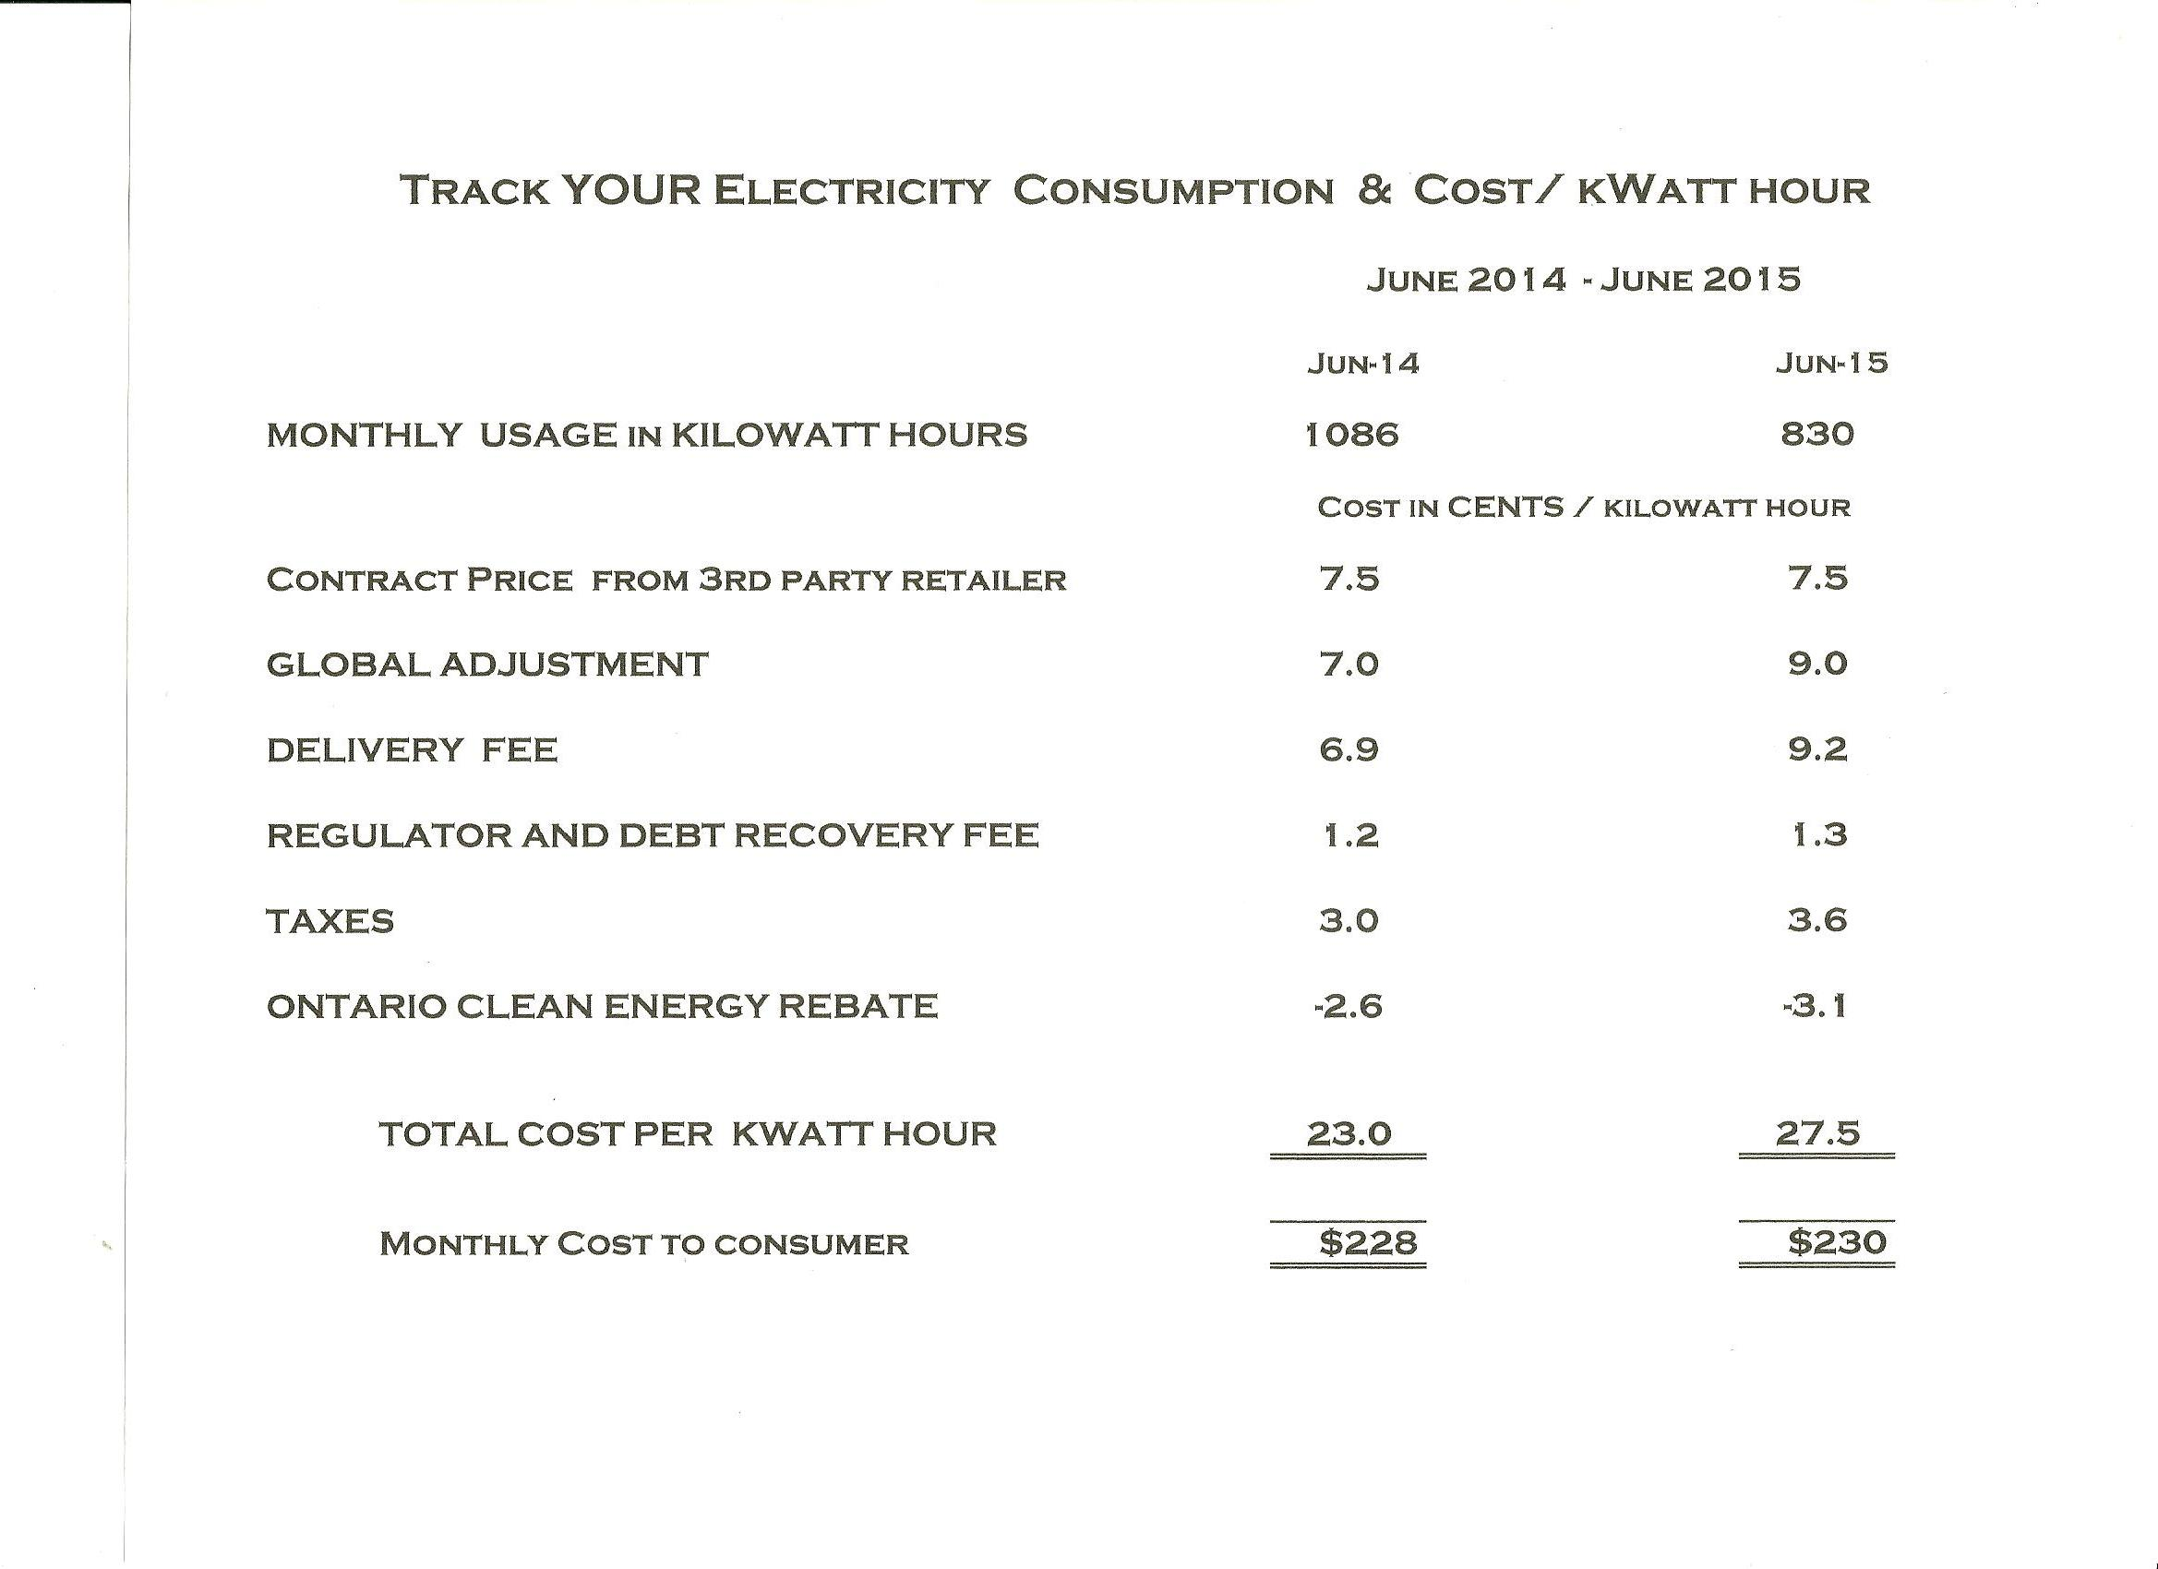

Slide 21
Investment Options
MiroFit for residential; FIT for commercial
good options from 2009 – 2014…???
as grid parity approaches, generation for own usage becomes competitive.
Off- Grid
requires Battery storage or generator or both
good option in a remote location.
a new build requires planning permission to go offgrid.
Net Metering – what does it hold for the future.
Any type of generation or hybrid mix ; battery storage; rate TOU ?
Usage = Generation over 12 months. What Cost ?

Slide 22
Household Consumption of Electricity

Slide 23
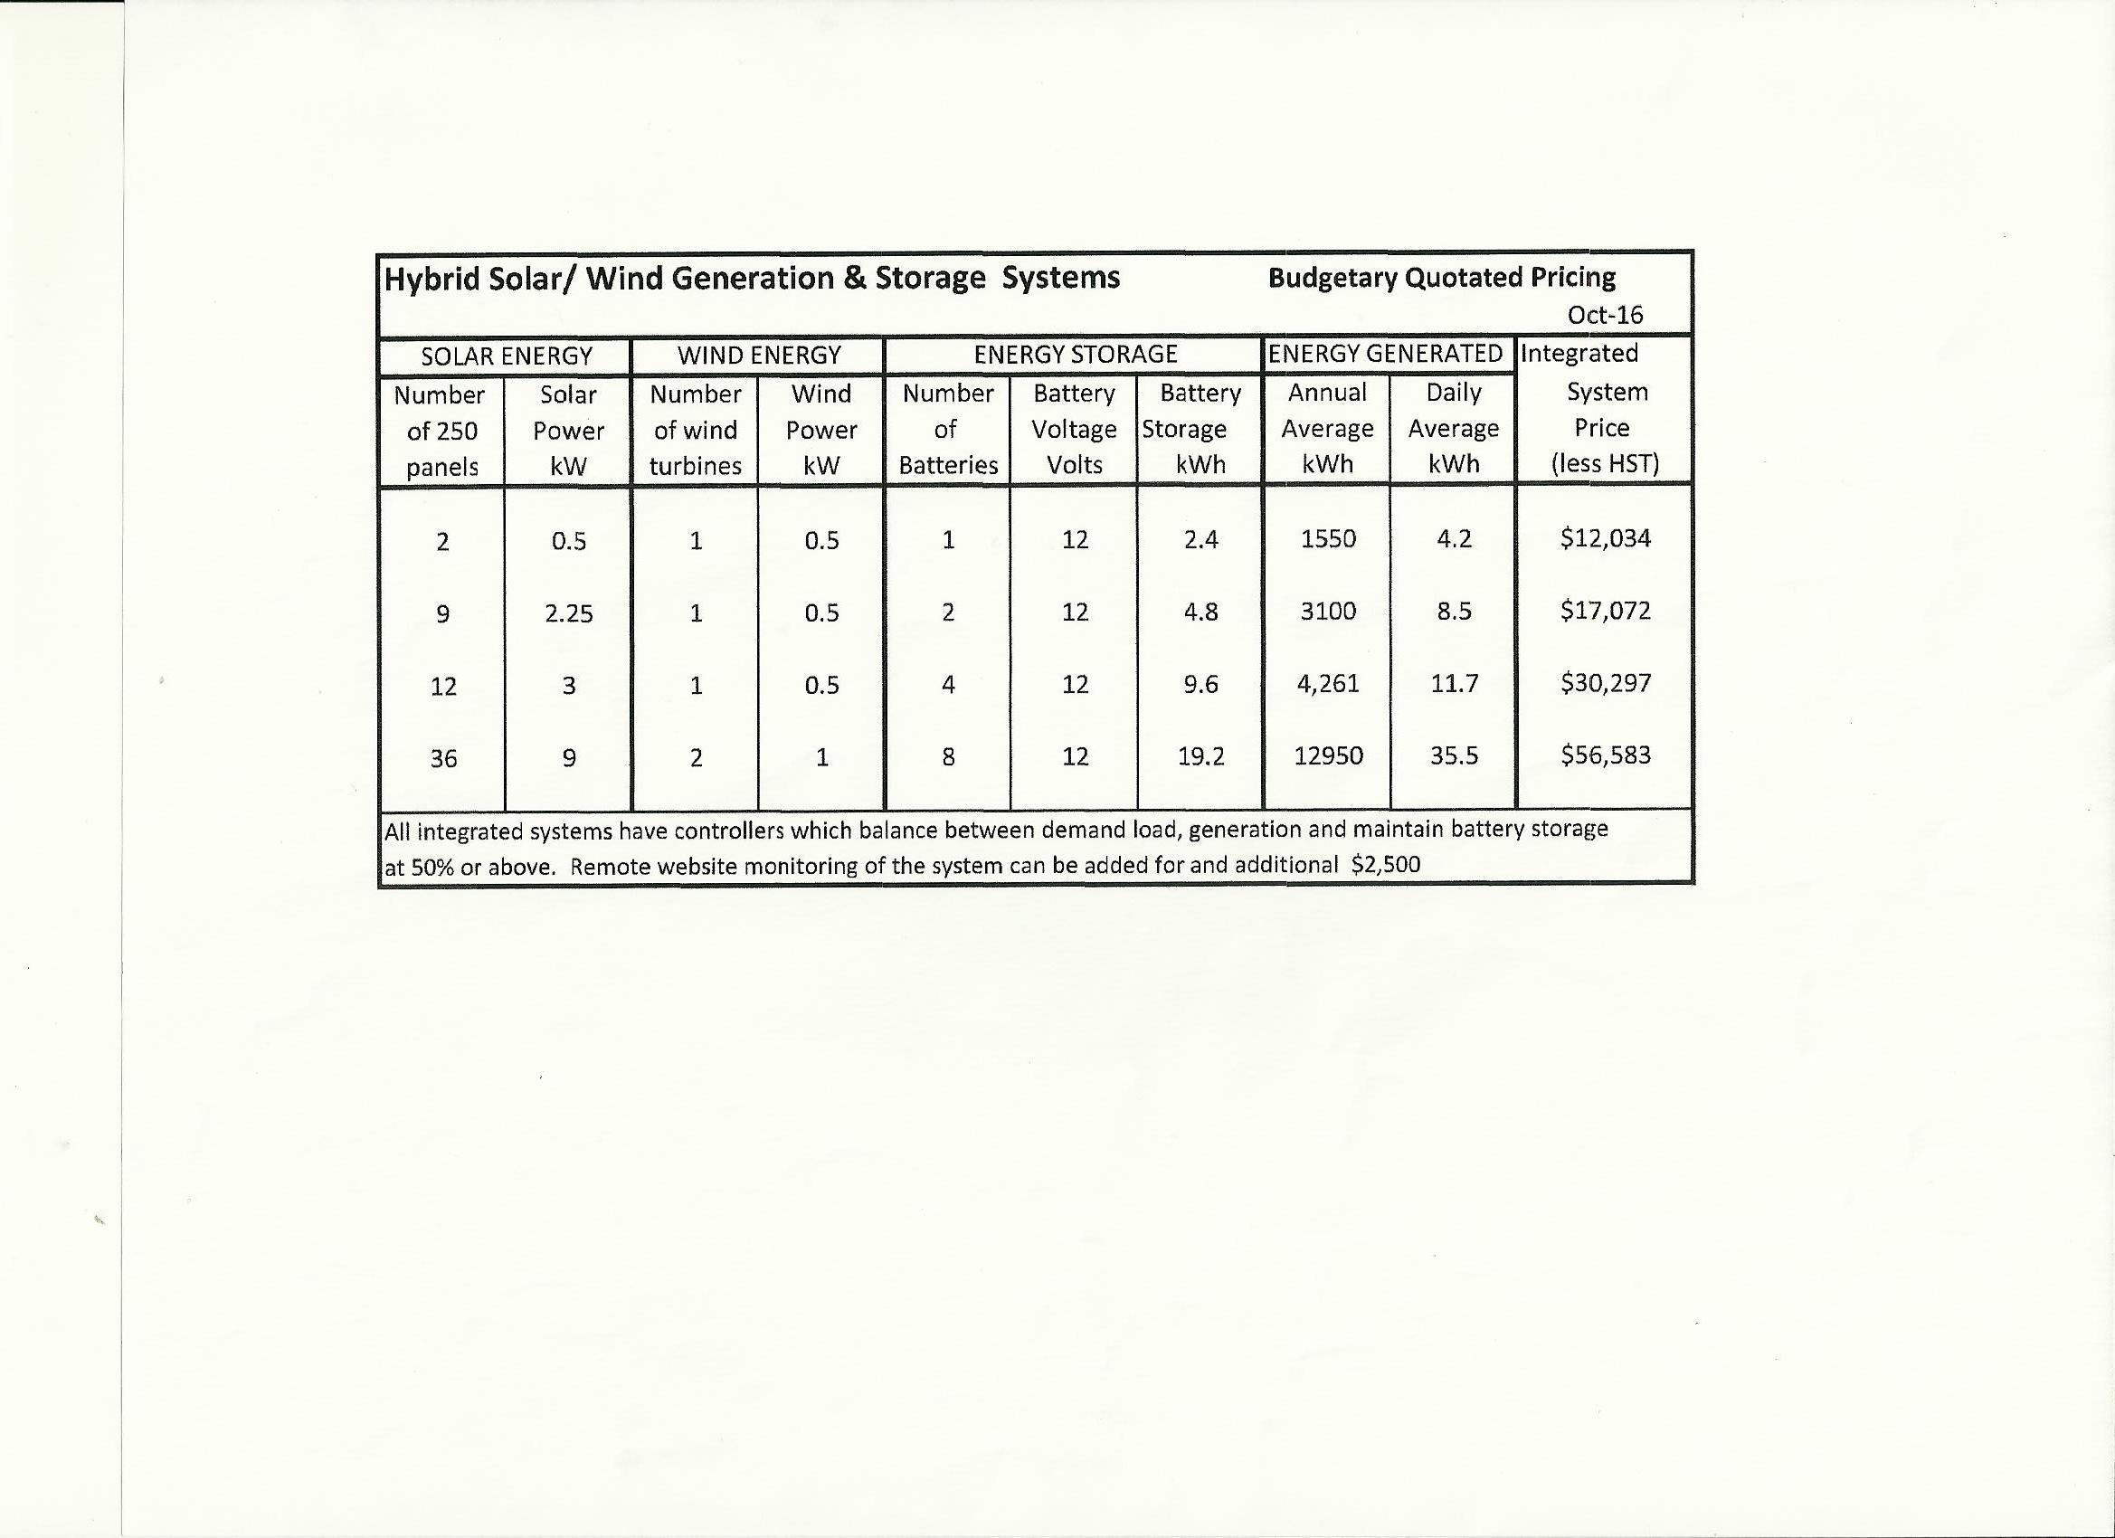

Slide 25
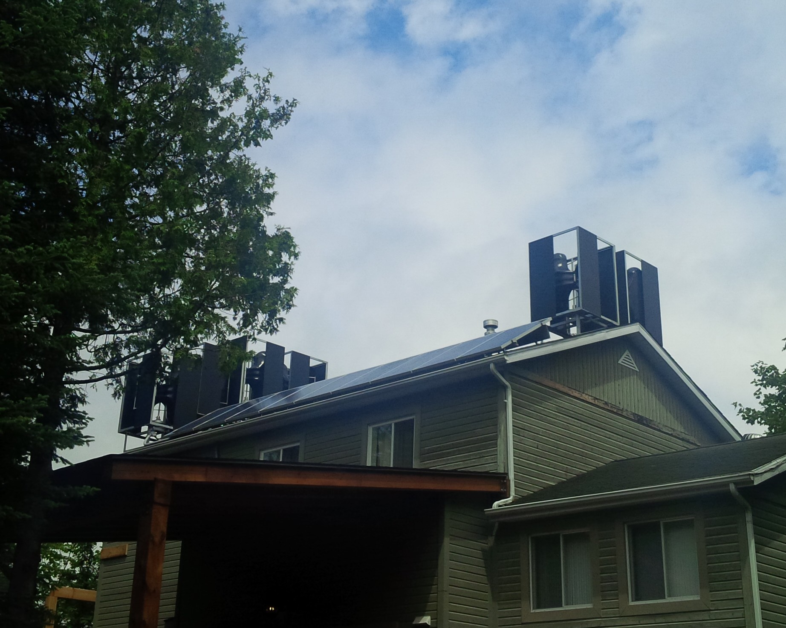

Slide 26
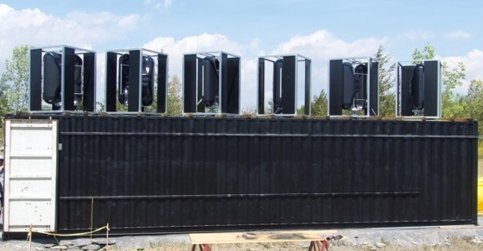

Slide 27
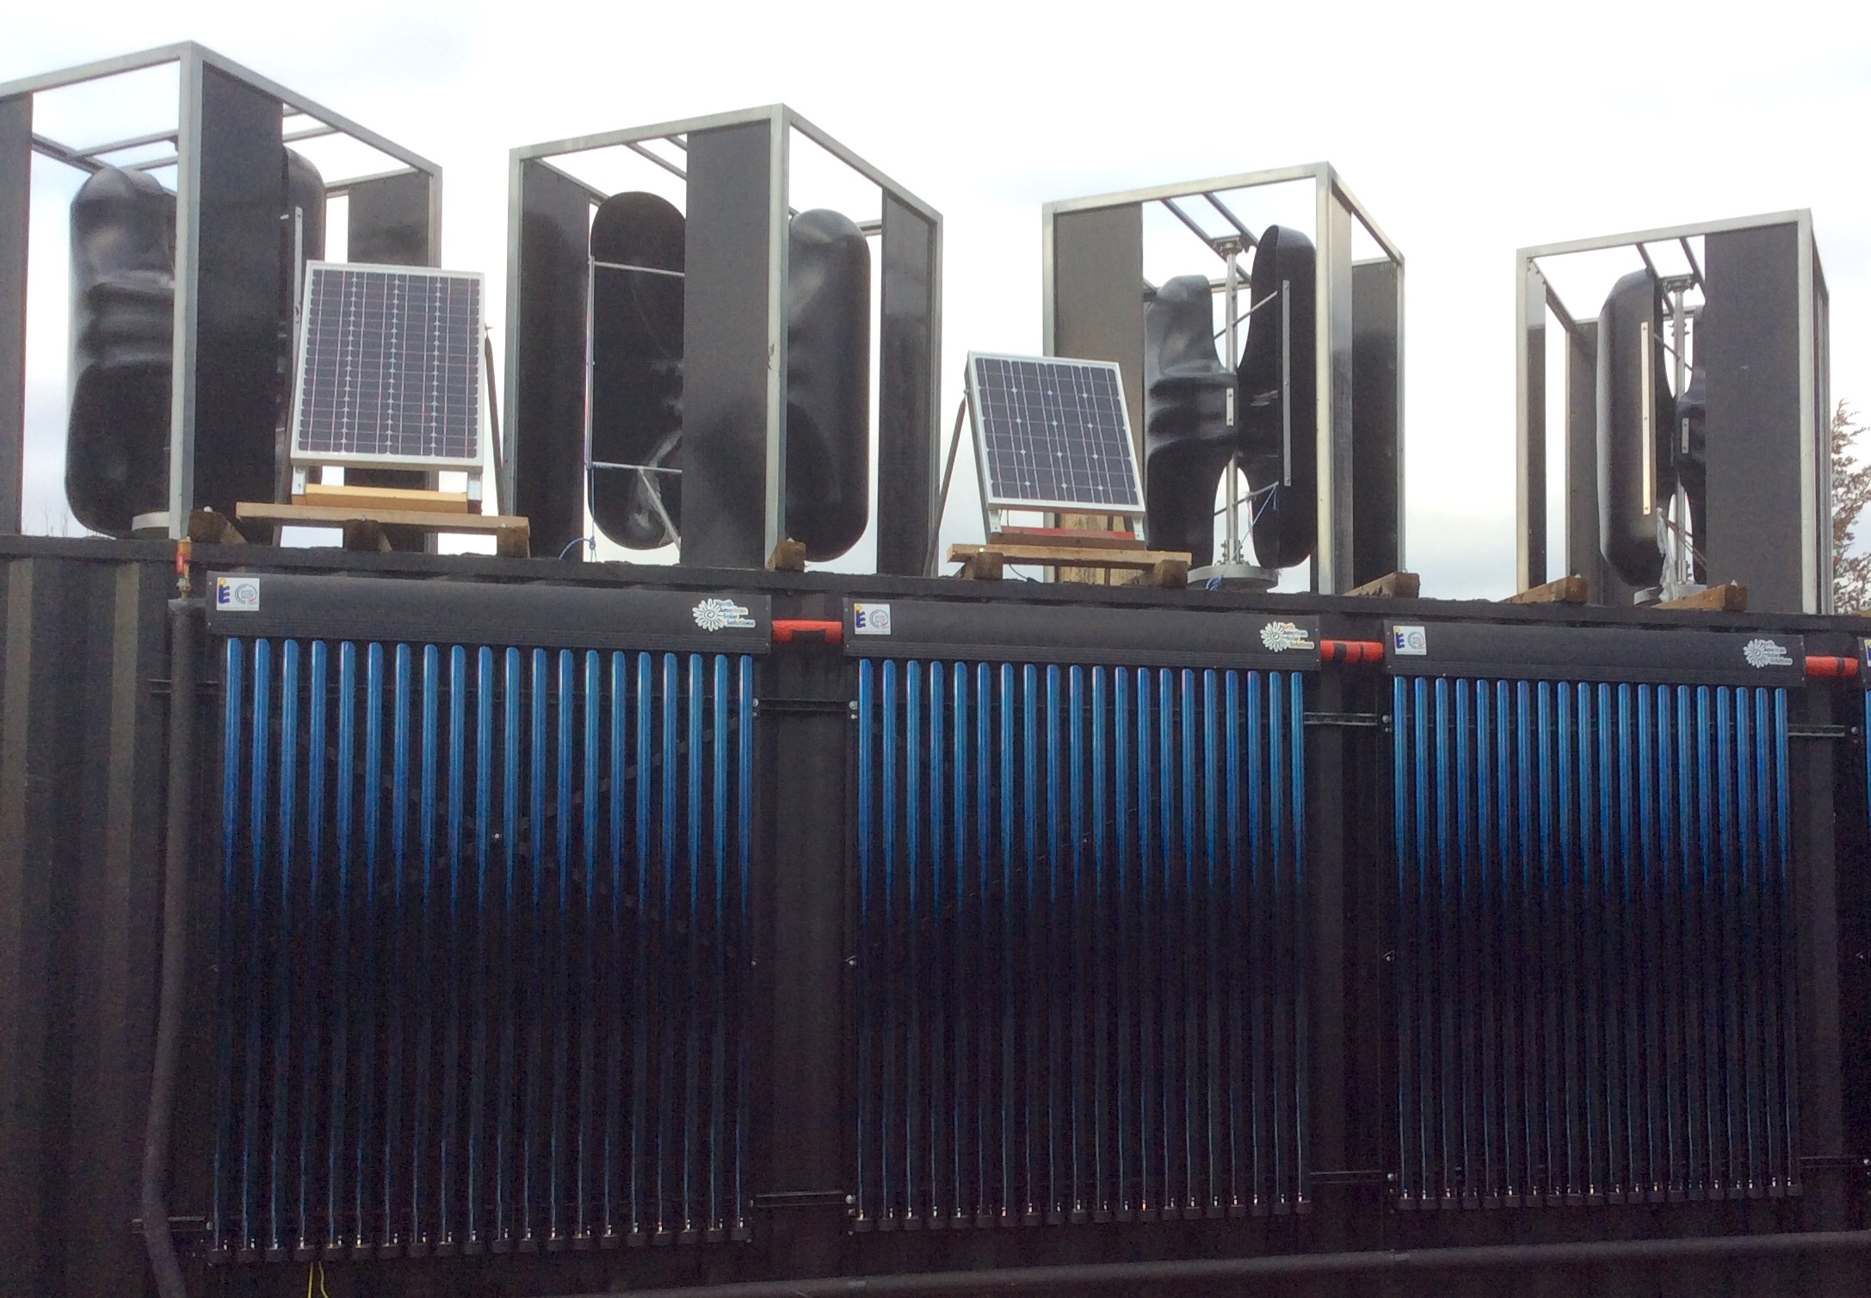

Slide 28
Conservation and Generation
Thought for the future
What you save in kW hours /day by using STHW heating and eliminating the use of electricity
Equals the amount of kWhours or Electricity to charge your EV and drive 50-60 kilometers every day

Slide 29
Energy Efficiency is a State of Mind.

