Slide 1
Switch Ontario
Presents:
Energy and Raw Materials: Where Will We Be in a Millennia or Two?
By James S. Juczak, Woodhenge Sustainable Community

Slide 2
Woodhenge Sustainable Community

Slide 4
Topics that could be covered:
Population trends
Agriculture and Food
Health, Medicine, Drugs, Mortality, Longevity
Sanitation and Vaccination
Housing
The “Health” of Planet Earth (Land, Water and Air)
Transportation
Religion and Politics

Slide 5
Logic vs…..

Slide 6
Greed

Slide 8
All energy is from the Sun
Oil, coal and natural gas are just stored solar energy from many years in the past.
70% of the US’s fossil fuel energy is imported.
The sun delivers approximately 1000 watts of power per square meter when it shines directly on a surface. The sun isn’t going away!
Wind and water power are the result of the sun’s influence on our planet. Wind and moving water aren’t going away.
The problem is that we’ve gotten used to the incredibly concentrated power of fossil fuels and have tried to ignore the problems they create.

Slide 10
What matters for the size of the world population is fertility not mortatlity Mortality is even inversely correlated with population growth

Slide 11
What is the maximum population the Earth can sustain? 10 billion people Many scientists think Earth has a maximum carrying capacity of 9 billion to 10 billion people. [How Do You Count 7 Billion People?] One such scientist, the eminent Harvard University sociobiologist Edward O. Wilson, bases his estimate on calculations of the Earth's available resources.Oct 11, 2011

Slide 12
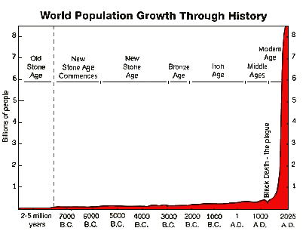

Slide 13
Reasons for Population Growth (and subsequent increase in resource depletion and energy use)
Sanitation
Vaccinations
Fossil Fuel Based Fertilizers
Fossil Fuel Based Transportation

Slide 14
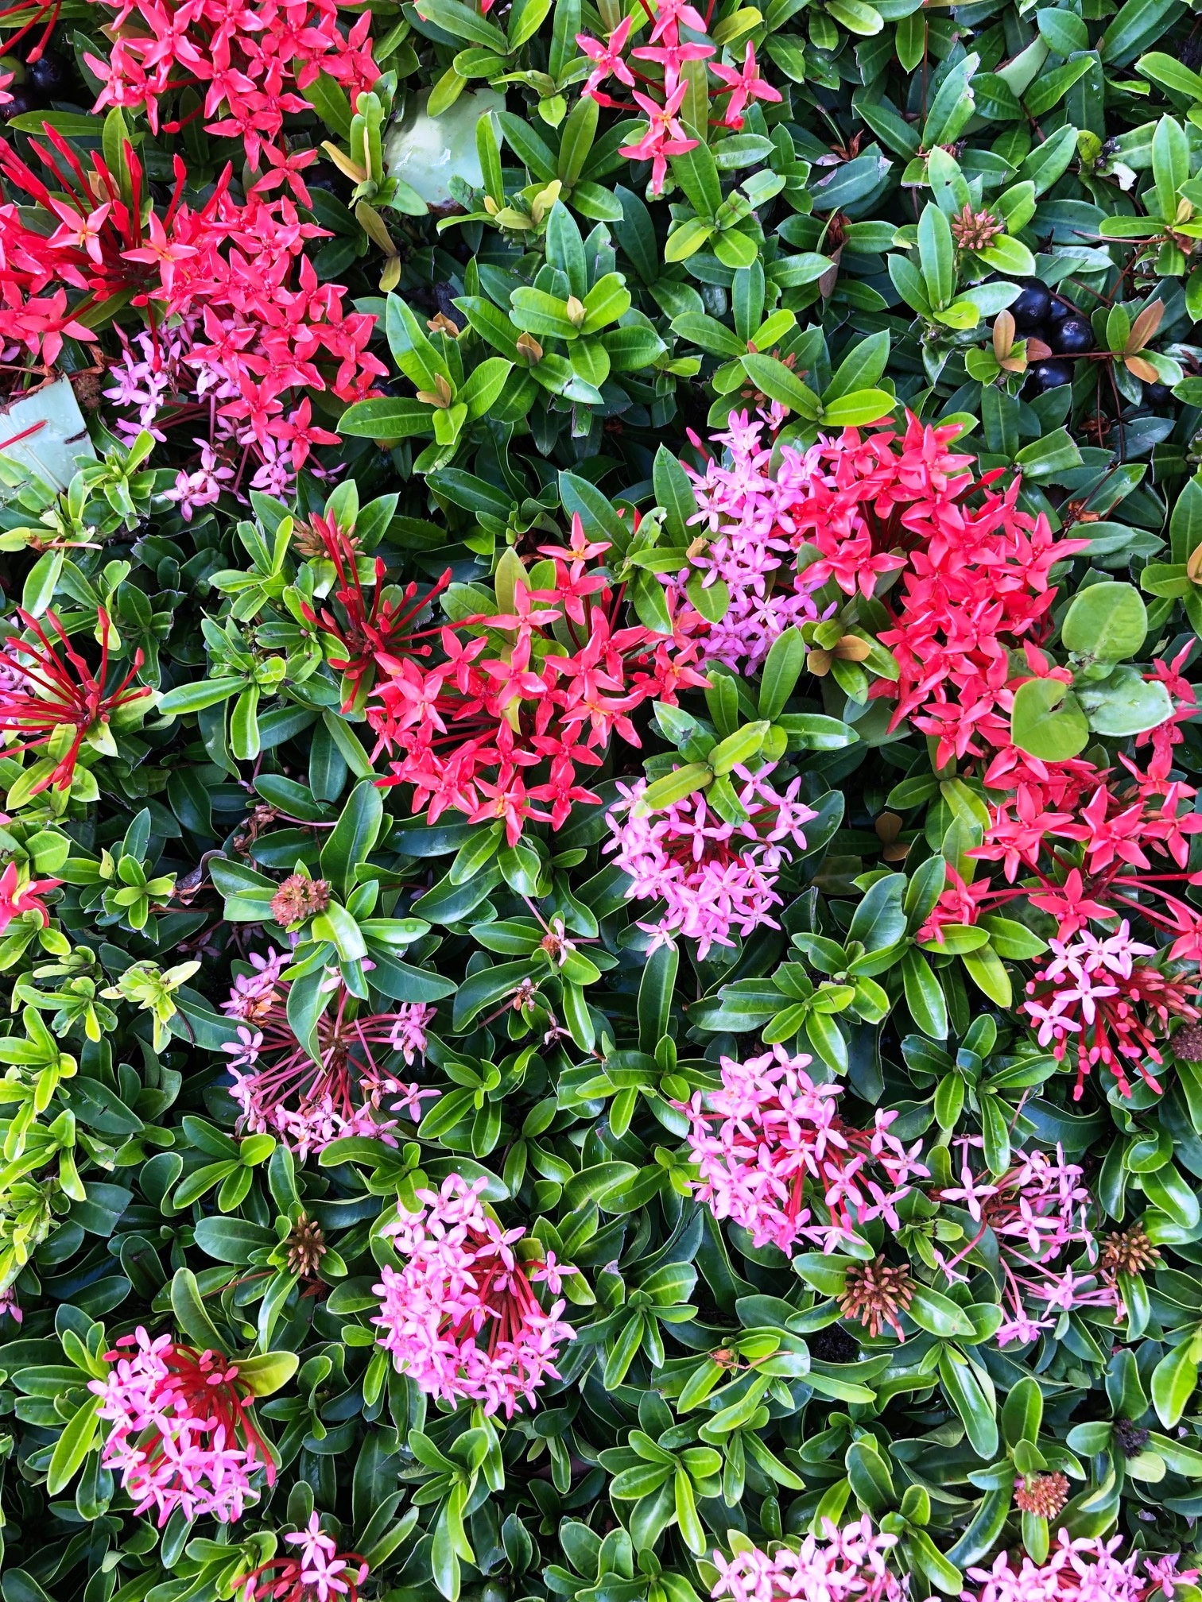

Slide 15
What We Try to Do

Slide 16
Moore’s Law (about 2 years)

Slide 17
Just as a crisis occurs…
Whales hunted to past “peak”…. lead to the petroleum industry…
War produced large airborne weaponry….electronics developed to provide accurate guidance…
Post WWII population boom …lead to rapid population growth …lead to nuclear power and synthetic fertilizers developed to meet demands…
The width of a horse’s ass is related to the design of the space shuttle. (James Burke: Connections)

Slide 18
Somewhere and Away
Containers of food and consumable products mysteriously appear on shelves for your convenience.
Water comes out of pipes with the turn of a lever
Gas stations will take a piece of plastic and turn it into dozens of gallons of fuel for your vehicles
Wires and pipes come into your home and automatically deliver electricity and heat
You put your trash in a bag and it disappears never to be seen again.
You do your business in a toilet and push a lever- magic happens and the smelly mess is gone.
You fill your car’s fuel tank and turn a key and through some slightly understood process the tank empties itself.
Turn a dial or flip a switch and heat and lights appear with no apparent connection to pollution.

Slide 21
Comprehensive Anticipatory Design Science What is Comprehensive Anticipatory Design Science and why is it relevant and critical in the today's world? (paraphrased from R. Buckminster Fuller) From a global perspective, we are faced with daunting challenges as documented by World Resources, 1996-97: the accelerating confluence of population expansion, increased demand for energy, food, clean drinking water, adequate housing, the destructive environmental effects of pollution from fossil fuels and nuclear waste, plus the growing divergence between the haves and have-nots and the potential for ensuing conflicts.

Slide 22
Likely Scenarios For Energy
Fossil Fuel supplies will continue to dwindle and increase in cost over the next hundred, or so, years.
Nano-technology improvements in electronics will lead to orders of magnitude in improved energy efficiency…solar cells, energy storage systems, cold fusion, thorium reactors, hydrogen based systems.
We will choose logical alternatives to energy and resource depletion practices we use presently.
Systems will be designed to utilize the least amounts of energy…housing, industry, transportation etc..

Slide 23
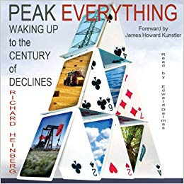

Slide 24
Likely Scenarios for Resources
We will “run out” of some resources…meaning they will become too expensive to use they way they are presently being used.
We will develop massive recycling, upcycling and landfill reharvesting/mining programs.
Products in the future will be deliberately designed to be “reutilized”.

Slide 26
Cradle to Cradle: Remaking the Way We Make Things by William McDonough, Michael Braungart
Key Concepts: 1. Resource management
2. Upcycling
3. Leaving a better earth for future generations

Slide 27
Limits to Growth
paraphrased from Stan Juczak:
“Modernization resulted in less effort to produce more …I like the example of bacteria in a flask with enough food. They will multiply until: a- they run out of food or b- they pollute their environment. In either case they no longer exist.”

Slide 28
Star Trek Future*
The original TV series “Star Trek” took place only about 300 years in the future (2265), they had:
1. Faster than light travel
2. Transporters
3. A socialist economy
4. colonies all over the ‘known’ galaxy.
5. You name a few!
6. Communicators
Already, in less than 50 years, inventions based upon this show are becoming reality – the tri-corder- or ubiquitous –the communicator – aka cell phone.
* For reference: “The Jetsons” was supposedly taking place on 2062!

Slide 29
In the year “0019” CE
We had lots of good things:
1. Agriculture
2. Rudiments of medicine
3. Alchemy
4. Water, wind and animal power
5. Navigational skills
6. Basic knowledge of the heavens
7. The ability to record knowledge

Slide 30
In the year 2019
We have more good things:
1. Nanotechnology
2. Human genome mapping
3. Synthetic food production
4. Space travel
5. Incredible knowledge storage potential
6. Artificial intelligence
7. Unfathomable interpersonal communication

Slide 31
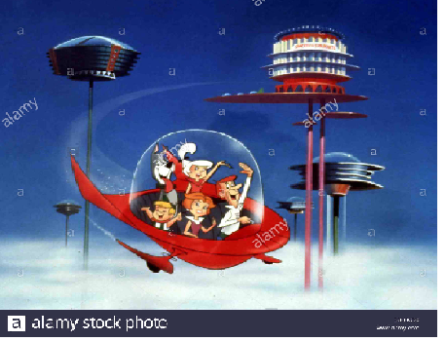

Slide 32
By the year 4019
Ummmm….given the rate of knowledge production and inventions/discoveries and assuming we don’t ‘die off’, I can’t do anything but guess here:
1. Faster than light travel
2. Infinite lifespan
3. Teleportation
4. Colonies all over our galaxy

Slide 33
How does this help “Switch Ontario”?
Understand in becoming energy independent utilizing renewable energy resources that you have to consider the following:
Patterns of energy use in multiple areas:
Transportation
Residential Housing
Industry
Import/Export
Trends in population and employment
i. Where will people live and work?
New and Emerging Technologies
WHERE IS THE WASTE?

Slide 34
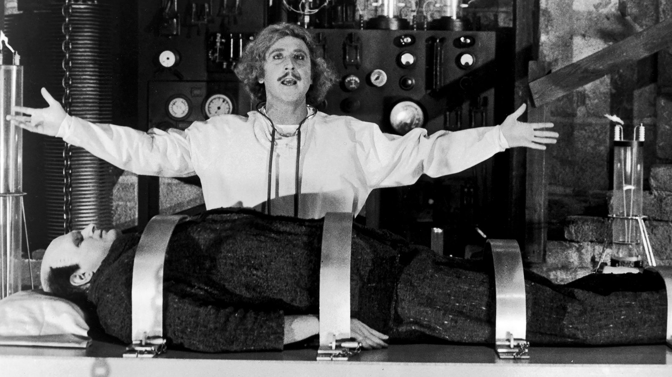
The future of energy in Ontario is ALIVE!

